Slide 1
WELCOME Please introduce yourself in the chat bar
INSERT THE TOPIC FOR YOUR HEAT WORHSHOP HERE
Improve access
Improve user experience
Improve outcomes
We will be recording the workshop to help us identify learning & actions. The recording will not be shared/published.

Slide 2
Welcome and Introduction
Scope of today’s workshop:
To have a structured conversation to share information and insights.
To consider what actions to explore further and identify next steps.
We will be using the Health Equity Assessment Tool (HEAT)
Participants from across: INSERT THE NAMES OF PARTICIPATING ORGANISATIOSN HERE
The priority areas that we will focus on is based on the data gathered and will be:
During the workshop we’ll hear from:
INSERT SPEAKER/FACILITATOR NAMES & ORGANISATIONS

Slide 3
Agenda
INSERT YOUR AGENDA HERE

Slide 4
Introduction- HEAT: four stages
The HEAT tool is designed to be used at the start of work to help you consider its potential impacts/effects, but it can be used retrospectively.
There are 4 stages but the tool can be used flexibly:
Prepare - agree the scope of work and assemble the information you require
Assess - examine the evidence and intelligence related to your work area or service
Refine and apply - focus on the most impactful actions and make tangible changes to work plans/service specifications, informed by evidence where possible
Review – consider progress against targets and make tangible changes to work plans or service, informed by evidence
Done
Next
Future

Slide 5
A. Prepare
Steps to take | Your response – remember to consider multiple dimensions of inequalities, including protected characteristics and socio-economic differences
Prepare – agree the scope of work and assemble the information you need
Your programme of work What are the main aims of your work? How do you expect your work to reduce health inequalities? | The priority area that we will focus on will be INSERT YOUR FOCUS HERE
Notes:
Complete in advance

Slide 7
SLIDES 8 - 13 ARE SOME EXAMPLES OF DATA SHARED AS PART OF A HEAT WORKSHOP FOCUSED ON UPTAKE OF CANCER SCREENING BY PEOPLE LIVING WITH SEVERE MENTAL ILLNESS (SMI) IN DORSET

Slide 8
Severe Mental Illness (SMI)
Severe mental illness’ (SMI) refers to people living with psychological problems including schizophrenia, bipolar affective disorder or other long-term psychotic illness and people receiving lithium therapy.
Data gathering process
We’ve compiled data from:
DiiS
OHID/PHE
NHS

Slide 9
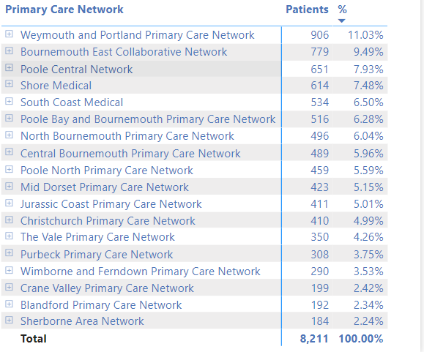
What do we know about people living with SMI in Dorset?
Context - Our population
8,211 people on the SMI register across BCP & Dorset
6,885 are active
4,125 are female and 4,085 are male
8% of people with SMI are from ethnic minority backgrounds compared to 4% of the general population
15% of people with SMI live in areas of Dorset within the 20% most deprived LSOAs in England.
Variation across Primary Care Networks
Source: Dorset Intelligence & Insights Service (DiiS)

Slide 10
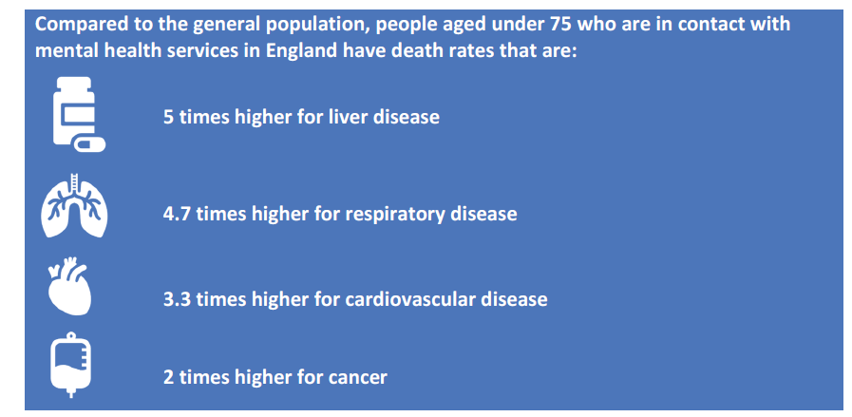
What do we know about the health & wellbeing of people living with SMI?
Nationally:
People living with SMI die on average 15-20 years younger than the general population
For people with SMI 2 out of every 3 deaths are from preventable disease
In the period 2016-2018 cancers was the leading cause of premature death among people with SMI
Source: https://www.gov.uk/government/publications/severe-mental-illness-smi-physical-health-inequalities/severe-mental-illness-and-physical-health-inequalities-briefing
In BCP & Dorset:
36% smoke compared to 14% of the general population
60% are overweight or obese
Source: Dorset Intelligence & Insights Service (DiiS)

Slide 11
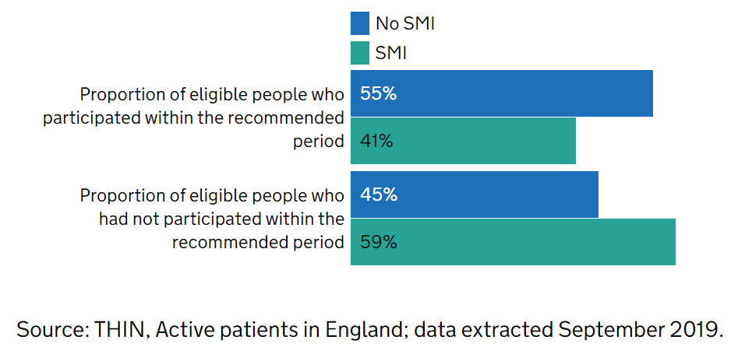
What do we know about participation in screening programmes by people living with SMI?
Nationally:
For those registered at their current GP for at least 2.5 years, 41% of eligible people with SMI participated in bowel screening within the recommended time period, compared to 55% of people without SMI
Notes:
time period than people without SMI.

Slide 12
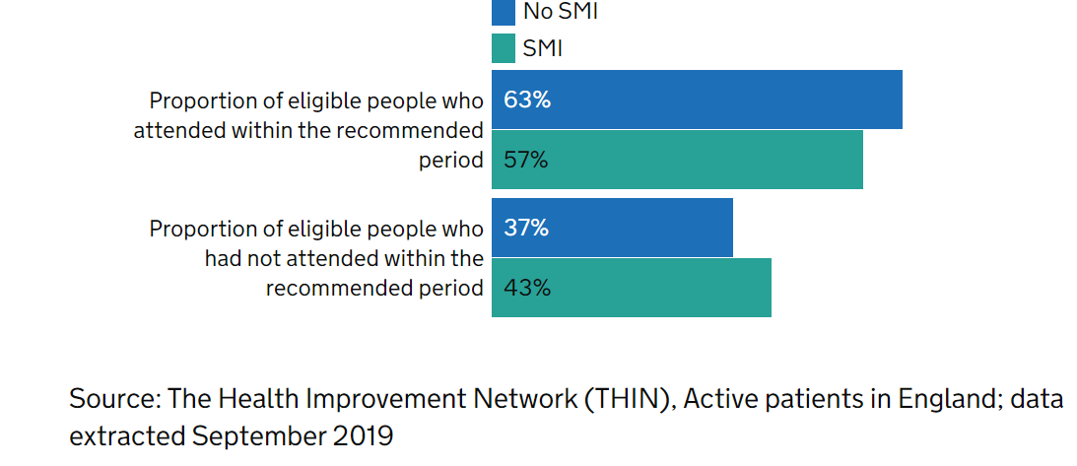
What do we know about participation in screening programmes by people living with SMI?
Nationally
Among eligible people who had been registered at their current GP for at least 3.5 years, 56.5% of the cohort with SMI had participated in breast screening within the recommended time period, compared to 63% of people without

Slide 13
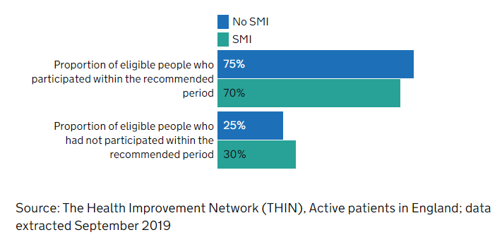
What do we know about participation in screening programmes by people living with SMI?
Nationally:
Among eligible people who had been registered at their current GP for at least 3.5 years (and aged 25 to 49) or 5.5 years (and aged 50 to 64), 70% of the cohort with SMI had participated in cervical screening within the recommended time period, compared to 75% of people without SMI
Notes:
time period than people without SMI.

Slide 14
Breakout rooms: Q1 What do you think are the key drivers for inequality in cancer screening for people living with severe mental illness?
INSERT THE FOCUS OF EACH BREAK OUT GROUP & WHO WILL FACILITATE IT e.g.
Breakout group 1:
Focus: Smoking & early pregnancy
Facilitator: Rupert Lloyd

Slide 15
Comfort Break

Slide 16
Feedback from breakout rooms

Slide 17
C Refine and apply initial ideas
C. Refine and apply – make changes to your work plans that will have the greatest impact
Potential effects In light of the above, how is your work likely to affect health inequalities? (positively or negatively) Could your work widen inequalities by: requiring self-directed action which is more likely to be done by affluent groups? not tackling the wider and full spectrum of causes? not being designed with communities themselves? relying on professional-led interventions? not tackling the root causes of health inequalities?

Slide 18
C - Refine and apply initial ideas
2. Action plan What specific actions can your work programme or project take to maximise the potential for positive impacts and/or to mitigate the negative impacts on health inequalities? How can you act on the specific causes of inequalities identified above? Could you consider targeting action on populations who face the biggest inequalities? Could you design the work with communities who face the biggest health inequalities to maximise the chance of it working for them? Could you seek to increase people’s control over their health and lives (if appropriate)? Could you use civic, service and community-centred interventions to tackle the problem – to maximise the chance of reaching large populations at scale? Who else can help?

Slide 19
D Review
Don’t focus on easier to reach communities- target/ time driven to achieve.
Take more time to reach ‘gap’ areas (i.e. disadvantaged groups) and build into project timelines.
Promote an equity tool with others in your service/locality

Slide 20
Breakout rooms: Q2 What actions can we take to address the drivers of inequalities in cancer screening for people living with severe mental illness? Q3 How would we know if we're making a difference?
Breakout 1 – Bowel Screening Rupert Lloyd & Martin White
Breakout 2 – Breast Screening Paul Iggulden & Ruth Webster
Breakout 3 – Cervical Screening Heidi Croucher & Vikki Andrews
Notes:
Insert the focus for each breakout room

Slide 21
Comfort Break

Slide 22
Feedback from breakout rooms

Slide 23
Blindspots
Please use the chat function to raise any further ideas or areas that you feel should also be considered

Slide 24
Next steps

Slide 25
Thank you
We welcome your feedback on what you think went well today & what we could do better.
Please post in the chat or email Rupert.Lloyd@dorsetcouncil.gov.uk

Slide 26
Five Key concepts and language for understanding health inequalities
Reference slides
Notes:
Suggest remove (JB)

Slide 27
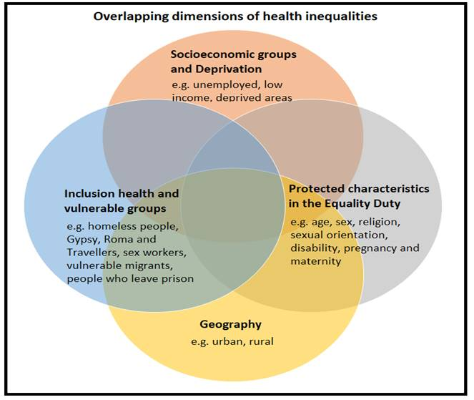
1) The Four Dimensions of Health Inequality
Notes:
Suggest remove(JB)

Slide 28
2) Social Gradient in Health
Life expectancy at birth by area deprivation deciles and sex, England, 2016-18
https://www.health.org.uk/publications/reports/the-marmot-review-10-years-on
p.16
Notes:
Suggest remove(JB)

Slide 29
2) Social Gradient and the Indices of Multiple Deprivation
English indices of deprivation 2019 - GOV.UK (www.gov.uk)
Notes:
Suggest remove (JB)

Slide 30
3) Clinical Care Contribution to Health
Hood et al 2015 County Health Rankings: Relationships Between Determinant Factors and Health Outcomes – ScienceDirect
Quoted by Andi Orlowski, NHS Health Economics Unit on 28.04.21
Notes:
Suggest remove(JB)

Slide 31
4) The Determinants of Health
Source: Kings Fund after Dahlgren and Whitehead (1993)
Notes:
Suggest remove (JB)

Slide 32
5) Inequality, Equality, Equity and Justice
https://onlinepublichealth.gwu.edu/resources/equity-vs-equality/
Notes:
https://onlinepublichealth.gwu.edu/resources/equity-vs-equality
Suggest remove(JB)

