Slide 1

Introduction to Project Management Framework
Background
The project management framework has been developed, with partners across Dorset, to provide a guide for anyone working within a project management setting across the ICS to be able to deliver projects in a consistent way.
The framework is relevant to healthcare in Dorset and flexible to meet the needs of all types of projects across the system.
It aims to remove any uncertainty around running a project by being clear about; the stages, roles and responsibilities, behaviours, competencies, processes and templates that are needed in a project.
Start
Planning & Design
Delivery
Close
Framework
The framework has four stages, and the purpose of this guide is to support you in managing your projects by defining the key activities in each stage and providing best practice advice, tools and templates.
The four stages of the framework can be found on the next page.
Click here
to enter
Table of contents
Framework stages

Slide 2
Introduction to Project Themes
Alongside the stages of the framework there are six themes that run throughout the whole project.
The themes are essential to the success of the project and need to be initiated in the start stage and reviewed, monitored and updated throughout the lifecycle.
The six themes are:
  Risk and Issue Management
  Resource and Team Management
  Communication and Engagement
  Change Management
  Assurance, Governance and Reporting
  Benefit Management
Return to Home

Slide 3








Home
  Click on the icon for guidance on how to navigate the framework
Themes
Start
Risk & Issue Management
Planning and Design
Resources & Team Management
Communication & Engagement
  Click on the icon for guidance on the tools that can be used throughout the framework
Delivery
Change Management
Close
Assurance, Governance & Reporting
Benefits Management
Framework Contents

Slide 4


Navigating the Framework
You can navigate quickly to the project stage you’d like to view by clicking the stage on the top banner.
The home button returns you to the main menu on page 2 of this guide.
To navigate between pages, use the arrow buttons at the bottom of each page
Tools and templates
To navigate to the themes click this image in the top right of the title bar and a themes menu will drop down. By clicking on the theme you wish to view you will then be taken to the first page of that theme.
Why are objectives important?
Look out for the hand symbol. Clicking here will reveal a pop up box with more information.
Return to Home

Slide 5

Links to Additional Resources
Each page also includes the below icons linking you to further resources. Click on them to reveal:
Tools and Templates
Project Management Glossary
Project Management Competency Wheel
Links to Training
When the wheel is in colour, click the wheel to show which competencies from Project Management Competency Framework the page content relates to.
Project Management Competency Wheel
Return to Home

Slide 6
Project Themes Overview
Risk & Issue
Management
Assurance, Governance
& Reporting
Resource & Team
Management
The aim of project risk and issue management is to support better decision-making through a good understanding of risks and issues and their likely impact.
Governance and assurance provides the mechanism for controlling and monitoring the project to enable project managers to provide confidence to decision makers in the projects viability.
Resource and team management is the process of pre-planning, scheduling, and allocating your resources and team to make the most effective use of resources and people on your project.
Communication &
Engagement
Benefits Management
Change Management
Benefits management is the identification, definition, planning, tracking and realisation of benefits.
A comms and engagement plan identifies the means, the medium, the messages and frequency of communication between the different stakeholders for the life of the project.
The purpose of change management is to implement strategies for effecting change, controlling change and helping people to adapt to change.
Links to additional resources
Start stage contents

Slide 7
Start Stage Contents
Start
  Introduction to the Start Stage
  Start Stage Tools & Templates
  Project Discovery
  Kick-off the Project
  Produce the Comms and Engagement Plan
  Create the Risk Register
  End the Stage
Planning and Design
Delivery
Close
Themes overview
Start stage intro

Slide 8
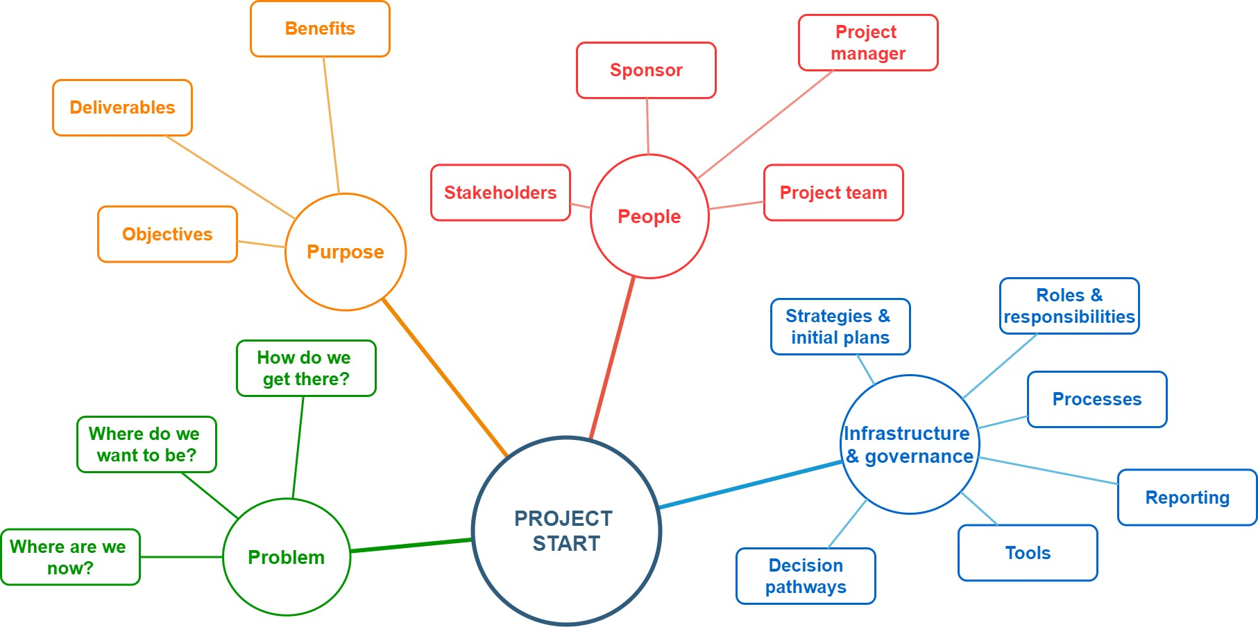
Start Stage Introduction
The start stage is the initial step in the project management lifecycle. In this stage, the idea for the project is explored and documented.
The goal of this stage is to examine the feasibility of the project and to determine who will carry out the project, who will be involved and whether the project has a compelling evidence base.
The project roles and responsibilities will be assigned, and work will begin.
​
Start stage contents
Start tools & templates

Slide 9
Start Stage Tools & Templates
The main tools and templates that you will use during the start stage are listed below, along with some key guides
to help you get your project started.
Further tools, templates and guides can be found in our Tools & Resources page on the website: Transformation – Our Dorset ICS Transformation
Tools & Templates
Guidance
Project Vision
Problem Definition Tools
  Fishbone Diagram
  Driver Diagram
  Affinity Diagram
SMART Objectives
Project Roles
Stakeholder
Terms of Reference
Project Proposal
Project Initiation Document
Impact Assessment - DPIA
Creating a Vision
Project Roles and Responsibilities
Stakeholder analysis
Stakeholder involvement
Impact Assessment - DPIA
Start stage intro
Project discovery

Slide 10
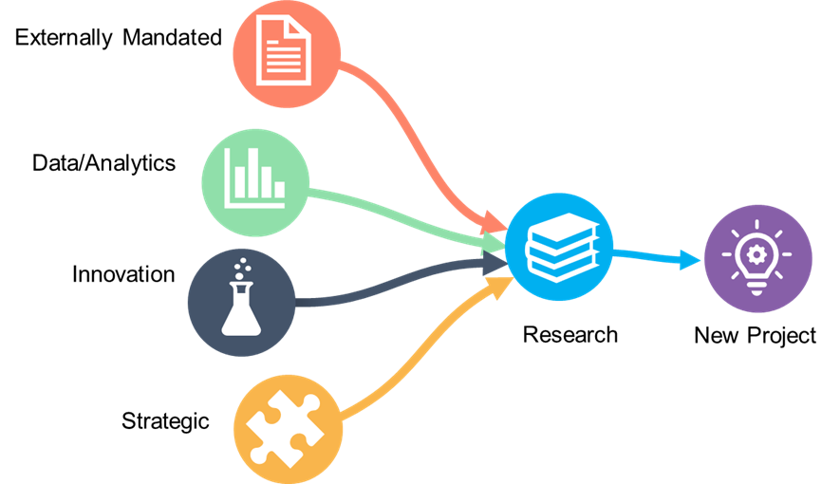

Project Discovery
Where do Projects Come From?
Projects are used to deliver change, and these changes often come from four main sources, as seen in the diagram.
A Project Proposal provides:
  Outline detail about the project
  Basic ideas and information available at the time
Research is then required to take the project forward and to start building the foundations.
Examples of project sources X
The four main sources are listed below with examples of what kind of projects each may initiate.
  Eternally mandated - for example NHSE directives or legislation changes e.g. change to data protection rules / Brexit
  Data/Analytics - statistical information driving change e.g. enhanced frailty care in areas of high elderly populations
  Innovation - implementation of new technology – e.g. online consultations
  Strategic - to achieve strategic goals e.g. projects to develop new ways of collaborative working
In addition to these there may also be event driven projects too.
  Event driven - projects to respond to unforeseen or predicted events – e.g. covid or winter planning
Helpful Tip Look for best practice and successes as well as reviewing lessons learned from previous
projects. This research is important as it will form the foundation of evidence your project is based on.
Start stage tools
Kick-off the project
Project structure & governance
Planning for success
Project delivery

Slide 11
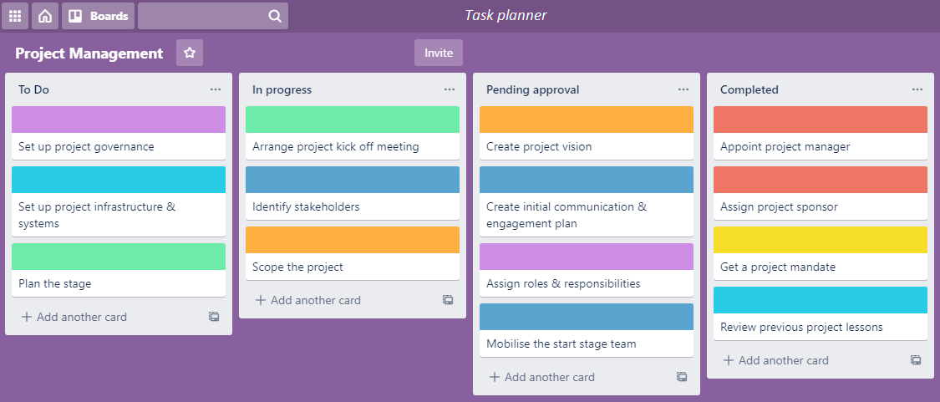

Initiating the Project
Click each of the tasks below to see more about the activities to kick-off a project. There is no set order to these but some tasks such as assigning a Project Manager/Sponsor need to be the first things to complete in order to do other tasks.
i
Appoint the project manager
Create a Project Vision
Appoint a project sponsor
Get a project mandate
The project manager is responsible for day-to-day management of the project and will control and drive the project through its entire lifecycle.
A vision is an idealistic view of the desired future to be created after successful project completion. It is a vivid description of what the business will be like to inspire the project stakeholders to initiate the project.
An important senior management role. The sponsor is accountable for ensuring that the work is governed effectively and delivers the objectives that meet identified needs.
The project mandate is the first to initiate a project. The mandate is considered to be a pre-project document; it encapsulates the ideas and basic information that is available at this point.
Project discovery
The project vision
Leadership & team management
Scope the project
Assign roles & responsibilities
Mobilise start stage team
Create initial comms & engagement plan
Set up project infrastructure & project systems
Plan the stage
Review previous project lessons
Set up project governance
Identify stakeholders
Arrange project Kick-offmeeting
Professionalism
Define the boundaries of the project; what is in scope, what is out of scope and set stakeholder expectations.
Assigning responsibilities for project team members boosts efficiency. Having a clear understanding of project roles allows the project manager to develop the project schedule with clear responsibilities about who is in charge of which task.
At the beginning of every stage the project manager will need to put in place the resources needed to complete that state. The start stage is no different and resources for the stage will be gathered ready to start work.
This is the first draft of your comms & engagement plan and will begin to identify stakeholders and how you will communicate with them. The plan will develop further in later stages as your project progresses.
Put in place all the space, systems and software that will be needed for the project. For example project MS teams sites, document storage, emails accounts, office space etc.
Plan what you are going to do in the stage, when you are going to do it and what resources you will need.
Reviewing lessons learned from previous projects is an important step in starting a project. It ensures that mistakes from previous projects are not repeated and best practice learned is applied in the future.
Put in place the set of policies, regulations, functions, processes, procedures and responsibilities that define the establishment, management and control of the project.
Project delivery
Identify and map all stakeholders for the project, That is any organisation or person who has an interest or role in the project or are impacted by it.
The first meeting of the project for the project manager to formally Kick-offthe project and refine the project vision.
Communications management
Project structure & governance

Slide 12

The Project Vision
What is the Problem? / What is the Project Purpose and Need?
One of the first actions for the project team and stakeholders is to develop a Vision for the project.
The Vision describes:
  What the business will be like after successful project completion
  It articulates what you are going to achieve
  It should inspire project sponsors and stakeholders to invest in and initiate the project
  Your aims and ambitions should be clearly documented
  What benefits and impact your project may have
  Projects need to be benefit driven to ensure maximum value from the investment in change.
Helpful Tip Remember, not all projects set out to solve problems, so if you’re
working on an opportunity, describe that instead (What does “good” look like?).
Kick-off the project
Develop the vision
Resource management
Professionalism
Project delivery
Planning for success
Scope management
Project finances

Slide 13
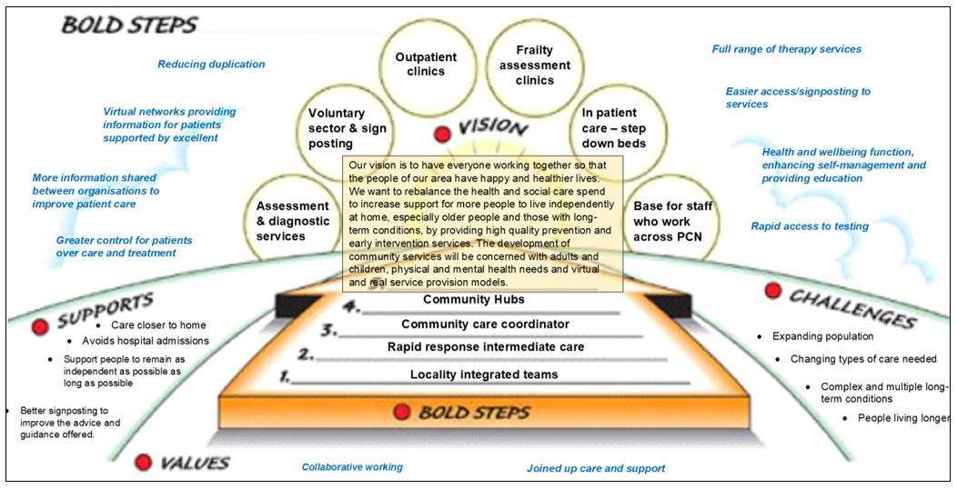
Develop the Vision
Example – visual style project vision X
Engage with other teams in this stage to gain their input and buy-in. Vision statements could also include visual elements to give a bigger impact.
Some examples of vision statements are below:
  “To make the best products on earth and to leave the world better than we found it.“ (Apple)
  “A thriving regional partnership improving population health and patient outcomes with global impact.” (Wessex Health Partners)
  “Our vision is to make Dorset the healthiest place to live. By working together, we can achieve the best possible improvements in your health and wellbeing.”(NHS Dorset – Joint Forward Plan: 2023-2028)
For more help with project visions, have a look at our Creating a vision guide in the tools and templates library.
Helpful Tip Remember, not all projects set out to solve problems, so you could describe what “good” looks like?
The project vision
Project governance
Resource management
Professionalism
Project delivery
Planning for success
Scope management
Project finances

Slide 14
Set up the Project Governance
Project Governance is the framework for how project decisions are made. It tells you what activities the project does, and who is responsible.
Project governance describes three elements these are known as the three pillars (shown in the diagram below).
Project Governance
Structure
People
People
Information
Structure
Information
Investing in effective project managers is key to any project. But first, senior management needs to understand their current activities. From this, project governance can establish the goals each PM should achieve. These goals need to be clear, reachable and sustainable.
The organisation’s structure and environment have to support the project. That means senior management is willing to invest time and energy to establish a vision for project managers to take forward. The “structure” element of project governance describes not just the immediate project team, but the organisation as a whole.
While it’s important to understand people, the process is even more important. Regardless of how many goals are set or what the vision is, every project will suffer without clear and consistent information sharing.
Click on each pillar to see more detail.
  Helpful Tip For further information on Project Governance, look at the Assurance, Governance & Reporting theme
Develop the vision
Roles & responsibilities
Project structure & governance
Planning for success
Project delivery

Slide 15
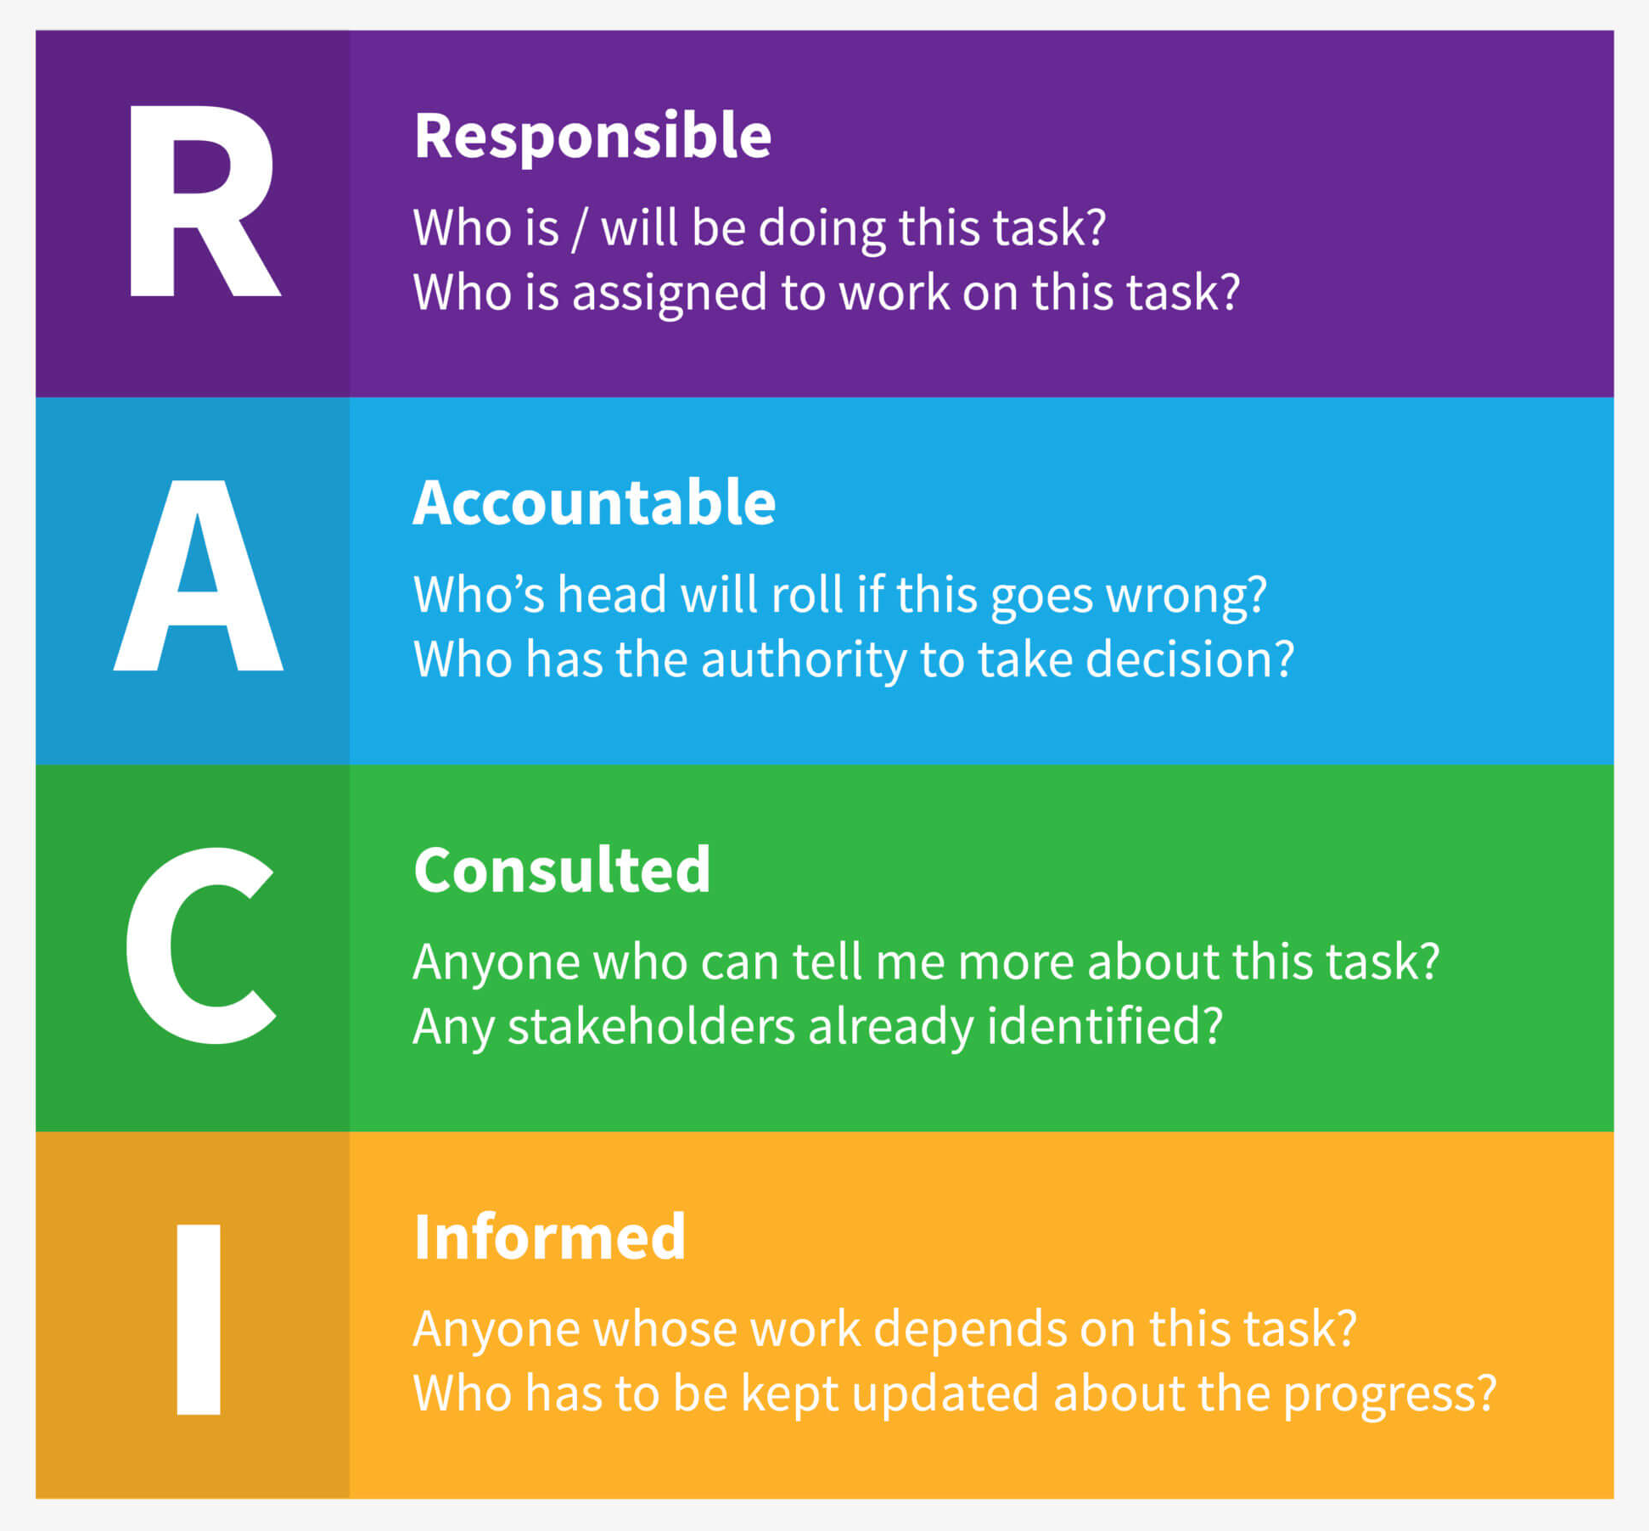
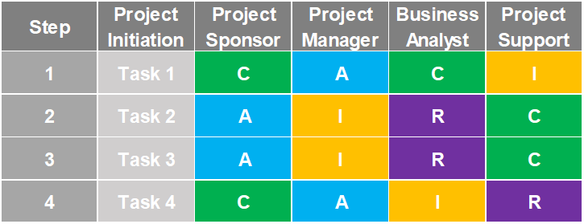
Roles & Responsibilities
A project should have defined and agreed roles and responsibilities within an organisation structure that engages the business, user and supplier stakeholder interests.
Each role will have different responsibilities within the project and one way of defining these is to use a responsibility matrix, for example the RACI model as shown below.
Project stakeholders are listed along the top of the chart and mapped against the tasks for delivering the project and the responsibility they will take.
Project governance
Problem definition
Project structure & governance
Planning for success
Project delivery

Slide 16
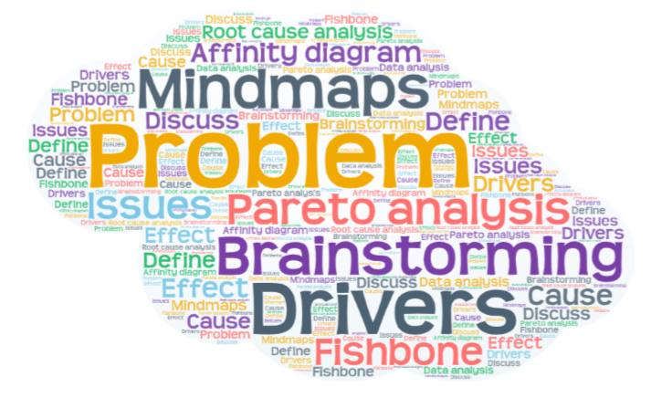
Problem Definition
      Problem Definition helps answer the question ‘What problem are we trying to solve?’
      By analysing the problem from different angles and using different tools available, we can identify multiple factors that need to be taken into consideration when designing a potential solution.
      Getting to the root cause of a problem will allow more robust solutions to be considered.
Suggested tools and templates to assist with Problem Definition include:
  Driver and Fishbone diagram template
  Root Cause (5 Why’s) analysis
  Affinity Diagram Template
  Helpful Tip A common mistake during problem definition is getting distracted by ideas of how to solve the perceived problems. Try to avoid jumping to potential solutions at this stage and focus on clearly defining the problem which you are trying to solve.
Roles & responsibilities
Project objectives
Project delivery
Communications management
Conflict management
Planning for success

Slide 17





Project Objectives
Objectives are the specific goals of the project to be achieved by producing deliverables and ensure they align to the organisation’s strategic objectives.
The objectives should be SMART
They do not contain words such as “optimise”, “maximise”, “minimise” and they do not have vague deadlines such as “Autumn” or “Quarter 3”. They are not “ongoing” and they should not describe what you plan to do, how you plan to do it, or what you plan to produce.
Measurable
Realistic
S
M
A
R
T
Specific
Achievable
Timebound
Problem definition
Identifying benefits
Leadership & team management
Resource management
Professionalism
Project delivery
Planning for success
Scope management
Project finances

Slide 18
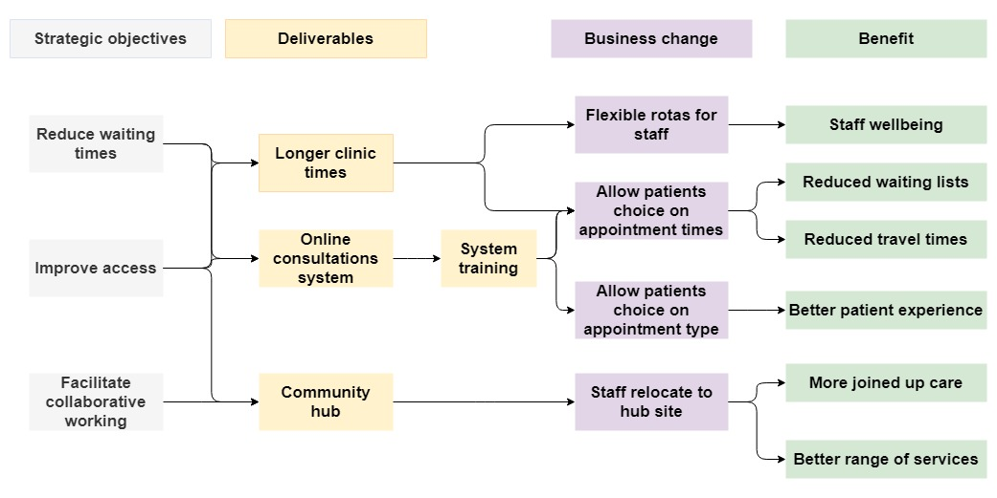
Identifying Benefits
Once the Project Objectives have been defined the project manager needs to think about what the expected Benefits and Dis-benefits of the project are and what benefits they need to realise in order to fulfil their objectives.
A Benefit can be defined the measurable improvement to existing and new business operations and services as to be delivered by the project.
Example benefits map X
Identifying benefits will:
  Help to clarify the underlying reason for the investment
  Highlight who will be affected by the project
  Indicate the level at which benefits may be expected
  Define when the benefits might be realised
There are many ways of identifying benefits including benefits workshops and benefits mapping.
Example benefits map
Helpful Tip See the Benefit Management theme for more information on identifying benefits.
Project objectives
Defining the scope
Leadership & team management
Resource management
Professionalism
Project delivery
Planning for success
Scope management
Project finances

Slide 19

Define the Scope
Scope defines the boundaries of the project including any assumptions, constraints or dependencies, which may include some of examples below:
  Geography (sites, offices, locations)
  Products
  Services or processes
  Resources (IT systems, people)
It is helpful to define, with key stakeholders, both what is in scope and what is out of scope. Agreeing what is out of scope will help to manage expectations about what the project will not deliver.
Details of the project scope will be defined in the Project Initiation Document.
  Helpful Tip Without defining the project scope, the cost and time that the project will take cannot be estimated.
Identifying benefits
Describe deliverables
Resource management
Professionalism
Project delivery
Planning for success
Scope management
Project finances

Slide 20
Project Deliverables
Examples of Acceptance Criteria X
Accuracy
Appearance
Availability
Capacity
Development Costs
Ease of Maintenance
Ease of Support
Ease of Use
Major Functions
Performance
Reliability
Running Costs
Security
Test Outcome Scores
Deliverables are the tangible or intangible products or services that the project will produce to achieve its objectives. The deliverables should be described and quantified and include the acceptance criteria.
  Acceptance criteria: the essential requirements or specific conditions that must be met for the deliverable to be accepted as completed.
  User Representative or Senior User: the person(s) that will ultimately use the product or service. The Project Manager will hand over the deliverable(s), along with the user guides and maintenance information.
Examples of Acceptance Criteria
Defining the scope
Communication plan

Slide 21
Create the Communication and Engagement Plan
Communication and engagement is key for any project to succeed and therefore it is critical to plan your approach and formally document this.
A Communication and Engagement Plan is a written document that ensures good, consistent communication is implemented from the start. It forms part of your project plan and it should be informed by your project schedule and risk plan.
The first draft of the plan should be completed at the outset of your project and continuously updated through the life of the project.
For more detail for the comms and engagement process please see the Communications and Engagement theme.
The Communication Management Process
A:
Identify audiences
B:
Analyse stakeholder interest and influence
C:
Understand comms and engagement needs
D:
Manage stakeholder expectations
E:
Take action
F:
Review and feedback
Describe deliverables
Start the risk register
Leadership & team management
Resource management
Professionalism
Project delivery
Communications management
Planning for success

Slide 22
Start the Risk Register
A Risk Register, also known as a Risk Log, is a document created to capture and track risks and the planned mitigation to reduce the impact to the project.
Identifying risks allows the Project Manager to assess and control uncertainty to the project. Effectively managing risks helps to deliver a successful project. Each risk is reviewed and updated regularly to record any changes in status.
Risks are scored based on the likelihood and consequence using a matrix scoring system. In ‘Our Dorset’ we use the
National Patient Safety Agency (NPSA) methodology.
Throughout each stage of the project, the Project
Manager follows the Risk Management Process,
for more information, please see the Risk Theme.
Communication plan
End the start stage
Leadership & team management
Resource management
Project delivery
Communications management
Planning for success
Scope management
Risk & issue management
Project structure & governance

Slide 23
End the Start Stage
Once all the activities for the stage have been completed, the stage will then require approval through the governance structure and a decision will be made to progress to the next stage.
The Project Manager
Ensures everything in this stage has been completed
Ensures that plans for the next stage are in place
Reflect on lessons learned throughout the stage and update the lessons learned log
The Project Sponsor
Review the work to date and the plans for the next stage
Confirm they are happy for the project to proceed
Gain approval through the governance structure
Commit resources to support the next stage
Create risk register
Planning & design
Communications management
Project structure & governance
Quality management & assurance

Slide 24
Planning & Design Stage Contents
Start
  Introduction to the Planning & Design Stage
  Planning & Design Tools & Templates
  Preparing for the Planning & Design Stage
  Solutions Development
  Options Appraisal
  Develop the Implementation Plan
  Set the Baseline
  The Business Case
  Sign Off the Business Case
  Procurement
  End the Stage
Planning and
Design
Delivery
Close
End the start stage
Stage introduction

Slide 25
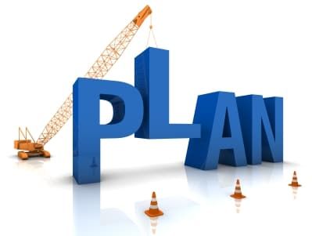
Introduction to the Planning & Design Stage
Once you have identified the scope and mobilised your project team, the next stage is to seek approval through developing the Business Case and to produce the detailed plans for how the project will be implemented before identifying all possible options.
This stage also decides on the option that delivers best possible value and proceeds with any procurement processes.
The business case is developed which consists of the deliverables, options appraisal, benefits analysis, risks, costs and time frames.
The purpose of the planning and design stage is to:
  Establish requirements for the project
  Establish cost, schedule, list of deliverables, and delivery dates
  Identify the resources for the project delivery
  Obtain management approval and proceed to the delivery stage
Planning & design steps
Tools & templates

Slide 26
Planning & Design Tools & Templates
The main tools and templates that you will use during the planning and design stage are listed below, along with some key guides to help you plan your project ready for implementation.
Further tools, templates and guides can be found in our Tools & Resources page on the website: Transformation – Our Dorset ICS Transformation
Tools & Templates
Guidance
Requirements Gathering (MoSCoW)
Impact Assessment - DPIA
Benefits Template
Gantt Planning, Schedule and Milestones
BPV Options Appraisal
Impact Assessment – DPIA Guidance
Introduction to stage
Planning for the stage

Slide 27
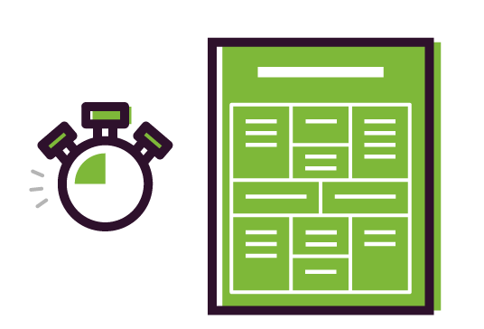
Preparing for the Planning & Design Stage
Preparing for the planning stage is ensuring that you have everything you need in order to succeed with your project.
The main components of planning are:
.
  Preparation of the project tasks and schedule
  Defining what resources will be needed and when
  Maintaining the risk register
  Updating the communication plan
  Undertaking impact assessments
  Sustainability planning
Impact Assessments
Equality Impact Assessment (EIA)
Data Privacy Impact Assessment (DPIA)
System / Quality Impact Assessment (SQIA/QIA)
More information and guidance on these can be found in our Tools & Resources page on the website: Transformation – Our Dorset ICS Transformation
Types of Impact Assessments
  Helpful Tip Sustainability planning could include environmental, financial and social
  impact. The Sustainable Development Management Plan (SDMP) workbook in the
  tools and templates library will provide more guidance on this.
Tools & templates
Solutions development
Leadership & team management
Resource management
Project delivery
Communications management
Planning for success
Risk & issue management
Project finances
Quality management & assurance

Slide 28





Solutions Development
Solutions development is the ability to determine the best means of satisfying requirements and explores the different ways to solve the problems identified in the previous activities.
This is done through gathering requirements from key stakeholders and identifying ways of meeting project objectives and producing the deliverables descriptions.
The outcome of this process is to:
  Have several viable options to consider
  Discourage premature decisions
  Include ‘Do Nothing’ as one solution
The solutions development guide explains
different techniques for doing this.
Options Appraisal
Solutions Development
Research and Test Ideas
Define Requirements
Preparing for planning
Options appraisal
Communications management
Conflict management
Planning for success
Scope management
Project finances
Quality management & assurance

Slide 29

Options Appraisal
Options appraisal is the process of selecting the best option to take forward your project by comparing the value delivered from each solution against the effort, resource and risk in implementing the objectives of the project.
The Best Possible Value (BPV) framework is one method for evaluating
options within a project.
Value
That way
This way
Decision makers have to decide whether the cost of undertaking the project is worth the reward. A cost benefit analysis can be utilised in order to show which options provide the best ‘value’.
To maximise value an option needs to improve outcomes or reduce resources (without compromising either).
The steps in an options appraisal should include:
  Identifying a list of options including ‘do nothing’ and ‘do minimum’
  Shortlisting the options (including ‘do nothing’) and a description of how these have been shortlisted
  Compare and score the options against the requirements & assessment criteria
The long way
Short way
Do nothing
What is meant by value?
Solutions development
Project milestones
Resource management
Project delivery
Planning for success
Scope management
Project finances

Slide 30

Project Milestones
A Milestone is a key event or step in the plan's schedule for example; the completion of a key work package/deliverable, the end of a development step or management stage. You need to identify your milestones before you can start developing your detailed implementation plan.
For reporting purposes only milestones and key tasks should be included in you project plan.
The key attributes of a milestones are:
  A point in time with zero duration
  Does not consume time or resources​
  Denotes commencement or achievement of a task
  Are a measure of progress
  Are used for reporting to directors/stakeholders
Options appraisal
Implementation plan

Slide 31
Develop the Implementation Plan
X
Linear Approach to Schedule Planning
A detailed plan monitors every move of the project until the very end addressing the main question: how?
It’s an essential document for keeping a project on track and needs to be kept updated throughout the whole project.
The detailed plan outlines:
  The scope
  Objectives
  Timeline
  Resources
  The deliverables of a project
Sequence the Tasks
Review the Critical Path
Build the Gantt Chart
Work Out the Costs Over Time
Specify the Deliverables
Assign the Resources
Set the Milestones
Estimation Durations of Tasks
Define the Required Activity/Tasks
Build in the Constraints
Build in the Comms and Engagement Activities
Approve Plan
Set the Baseline
Example schedule planning approach.
Project milestones
Agile planning
Leadership & team management
Resource management
Project delivery
Communications management
Planning for success
Scope management
Risk & issue management
Project finances
Project structure & governance
Quality management & assurance

Slide 32
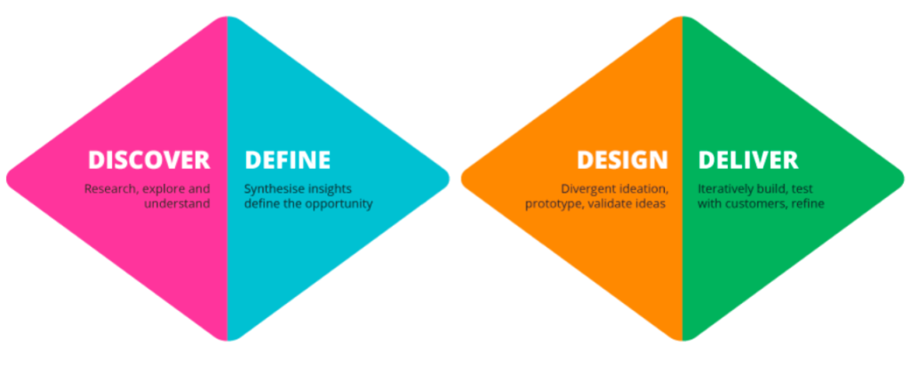
Agile planning
This framework is based on a Linear or Waterfall lifecycle where each phase must be completed before the next phase can begin and there is no overlapping in the phases.
Many organisations use Agile planning, which is a project planning method that estimates work using self-contained work units called Iterations or Sprints.
An example is the Design council model of:
  Discover
  Define
  Develop
  Deliver
Further information on Agile planning will be
added soon in a separate Agile projects guide.
What is a Sprint?
Sprints are periods of 1-3 weeks in which the project team focus on a small set of work items and aims to complete them within the sprint. Agile planning defines which items are done in each sprint, and creates a repeatable process, to help teams learn how much they can achieve.
What is a Sprint?
Implementation plan
Estimating & resourcing

Slide 33

Estimating and Resource Planning
Estimating is a critical part of project planning, involving a quantitative estimate of project costs, resources or duration.
Successful projects rely upon accurate estimating to ensuring that resources are identified and in place at the right levels, when needed in order to deliver on time, to cost and budget.
Resource planning includes:
  Estimating
  Acquiring
  Allocating
  And managing the resources required for a project.
A resource plan can help you do this. Click here for a
resource plan template.
More information
More information on can be found in the Resource and Team Management theme and the estimating guide (coming soon) in the PMO tools and templates library
More information
Agile planning
Project constraints
Resource management
Project delivery
Planning for success
Scope management
Quality management & assurance

Slide 34
Project Constraints
Cost Constraint
Assumption
When planning the project manager needs to consider the restrictions or limitations that the project is bound by – known as constraints.
The three primary constraints that project managers need to consider are:
  Time
  Scope
  Cost.
The triple constraint diagram is to the right.
In addition to these three, there may also be other constraints to consider
e.g. legal/legislation, environmental or technical constraints.
Click on each constraint on the diagram and below to find
out more about each of these.
Dependencies
Risk
The cost of the project, often dubbed the project’s budget, comprises all of the financial resources needed to complete the project on time, in its predetermined scope. Keep in mind that cost does not just mean money for materials—it encompasses costs for labour, vendors, quality control and other factors, as well.
A statement that is taken as being true for the purposes of planning, but which could change later. An assumption is made where some facts are not yet known or decided and is usually reserved for matters of such significance that, if they change or turn out not to be true, there will need to be considerable re-planning.
The relationship between products or activities. For example, the development of Product C cannot start until Products A and B have been completed. Dependencies can be internal or external.
Time Constraint
Quality
COST
Scope Constraint
Is an uncertain event or set of events that should they occur will have an effect on the achievement of objectives. It consists of a combination of the probability of a perceived threat or opportunity occurring and the magnitude of its impact on objectives.
The time constraint refers to the project’s schedule for completion, including the deadlines for each stage of the project, as well as the date for rollout of the final deliverable.
Quality defines what specifications your deliverables will be completed to. If there are changes to time, cost or scope then quality will be affected.
Scope refers to the totality of outputs for your project and the boundaries to which they are bound by. For example, number of items produced, geographical area, type and size.
SCOPE
QUALITY
TIME
Risks
Assumptions
Dependencies
Estimating & resourcing
Gantt chart
Resource management
Project delivery
Planning for success
Scope management
Risk & issue management
Quality management & assurance

Slide 35
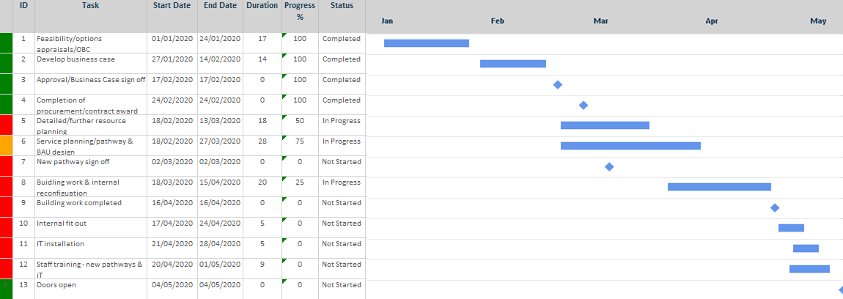
Gantt Charts
Gantt charts are useful for planning and scheduling projects. They help you assess how long a project should take, determine the resources needed, and plan the order in which you'll complete tasks. They're also helpful for managing the dependencies between tasks.
Task ID
Task Description
Status
Task Duration
Milestone
Critical Path
The critical path method is used to calculate the shortest length of time needed to complete a project and to determine the amount of float for activities that are not part of the critical path.
For more information please refer to the guide to planning in the tools & templates library.
Start and End Date
Percentage Complete/Progress
The Critical Path
Project constraints
Baseline
Leadership & team management
Resource management
Project delivery
Planning for success
Scope management
Project structure & governance

Slide 36
Set the Baseline
A project’s baseline is defined as the planned scope, cost and schedule. It is a fixed reference point to measure and compare your project’s progress against.
The baseline should not be changed without following formal change control procedures.
When a significant project change occurs, a project should be re-baselined.
If this happens, it’s recommended practice to save the old baseline first, then create the new baseline as a new plan, so you do not lose that historical data.
Gantt chart
Business Case
Leadership & team management
Resource management
Project delivery
Planning for success
Scope management
Project structure & governance

Slide 37
The Business Case
The business case recommends which option to take through to implementation. In doing this the decision makers are committing the resources required to deliver their agreed option and allowing it to proceed to delivery.
Decision makers will use the information within the business case and the implementation plan to determine which option to proceed with.
Baseline
Business case sign off
Resource management
Project delivery
Communications management
Conflict management
Planning for success
Scope management
Risk & issue management
Project finances
Quality management & assurance

Slide 38
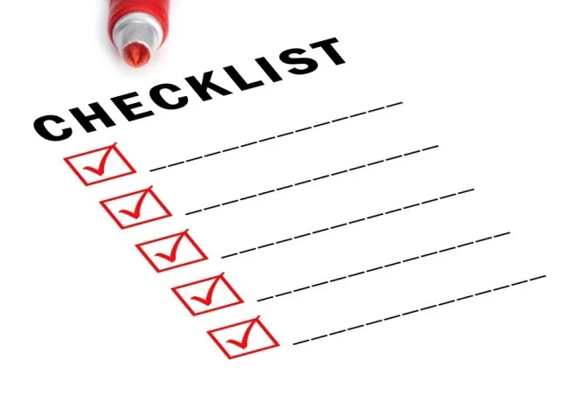
Business Case Sign Off
Business case assurance is a robust process to ensure that authorising the project will benefit the organisation and provides a compelling reason for the case for change.
In order for your project to be approved it is necessary for your sponsor to sign off the business case.
To do this you need to give decision makers confidence in your project proposal and make a case that the project is viable.
Financially viable
Deliverable
Clinically endorsed
Align to strategic objectives
    Helpful Tip Remember the business case is ‘living document’ and should be reviewed throughout the duration of the project to ensure that the project will still be viable and the benefit will be realised.
Business Case
Procurement
Resource management
Professionalism
Communications management
Planning for success
Project structure & governance
Quality management & assurance

Slide 39
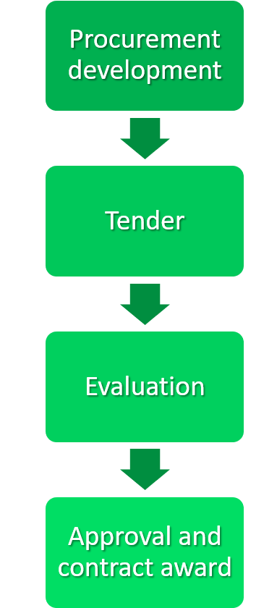
Procurement
Procurement is a legal process for public sector organisations for finding and agreeing terms, and acquiring goods, services or works from an external source, often via tendering or a competitive bidding process.
Successful procurement results in the awarding of a contract to the chosen supplier.
The process for awarding a contract to a provider is dependent on the total contract value.
Typically, if a service or product value is under £100,000, an award of contract can be made with the submission of three quotes or the completion of a waiver. This does vary from organisation to organisation, and it is always best to check with your procurement or finance teams to understand your value threshold and process.
Any contracts of a value of £100,000 or more, generally need to go through a competitive tender process.
Most organisations will have procurement teams to help you through this and provide advice and guidance, so we would recommend that you contact them before you start any procurement activities.
An outline process for procurement is shown below, although there are a number of steps within each stage that need to be completed and it can become quite complex, especially in larger projects
Business case sign off
Procurement process
Resource management
Communications management
Planning for success
Project finances

Slide 40
Procurement Process
2 – 4 weeks
Procurement Development Phase
Tender
Evaluation
Approval and Contract Award
Recommendation report approved by Corporate office or board
Contract award decision notification confirmed to suppliers
Standstill period 10 calendar days
Contract award & signatures
Contract implementation
Commercial services engagement
Specification development and market engagement
Assessment of contract value
Request commercial services support
Develop tender pack & evaluation plan
Selecting suppliers and inviting them to submit tenders
Respond to clarification questions
Submitted tenders reviewed for compliance with key participation requirements
Evaluation review tenders and raise any clarification questions
Evaluation panel moderation meeting for consensus scoring of tenders
Contract award decision approved & documented
Procurement
End the stage
Resource management
Communications management
Planning for success
Project finances

Slide 41
End the Planning & Design Stage
The end of this stage marks the move from detailed planning of your project and into delivery. The stage now requires approval through the governance structure and a decision will be made to progress to the next stage.
The Project Manager
Ensures everything in this stage has been completed
Ensures that plans for the next stage are in place
Ensures any procurement activities have been completed
Reflect on lessons learned throughout the stage and update the lessons learned log
The Project Sponsor
Review the work to date and the plans for the next stage
Confirm they are happy for the project to proceed
Gain approval through the governance structure
Commit resources to support the next stage
Procurement process
Delivery stage

Slide 42
Delivery Stage Contents
Start
  Introduction to the Delivery Stage
  Delivery Stage Tools & Templates
  Delivery Stage & Monitoring
  Mobilising Resources
  Role of the Project Manager
  Reporting
  Change Control
  Signing off the Deliverables
Planning and
Design
Delivery
Close
End the stage
Introduction

Slide 43
Delivery Stage Introduction
Once the business case is approved, the project moves into the delivery stage. This stage of the project is all about creating the deliverables according to your implementation plan.
The project manager needs to coordinate all the resources and keep team members focused on their assigned tasks in order to create the deliverables on time, to budget and to the specified quality to achieve the project objectives. .
MONITOR
    Regular monitoring and reporting on progress
    Takes corrective action to ensure the project is delivered
ACTION
    Controls scope and change requests
    Manages risks & issues and plans mitigation
CONTROL
MANAGE
Contents
Tools & templates

Slide 44
Delivery Stage Tools & Templates
The main tools and templates that you will use during the delivery stage are listed below, along with some key guides to help you deliver your project successfully.
Further tools, templates and guides can be found in our Tools & Resources page on the website: Transformation – Our Dorset ICS Transformation
Tools & Templates
Resource Management Plan
Objectives and Deliverables
Highlight Report (blank)
Highlight Report PowerPoint Template
Benefits template
Introduction
Planning

Slide 45
Planning in Phases & Monitoring
In large projects it is good practice to phase the delivery by breaking the project into distinct parts or phases and then planning each phase as a mini project. During the project delivery stage the actions identified in the project implementation plans are undertaken.
Throughout the delivery stage there is regular monitoring and reporting to ensure that the project remains on track.
The process of monitoring can be achieved in a number of ways:
Phased Progression
Milestones Progress
End of Stage Reporting
Scope and Cost Reporting
Tracking Deliverable Quality
Risks and Issues Reviews
Highlight and Exception Reporting
Deliverable Status Monitoring
Tools & templates
Mobilising resources
Leadership & team management
Resource management
Project delivery
Communications management
Planning for success
Scope management
Risk & issue management
Project finances
Project structure & governance
Quality management & assurance

Slide 46
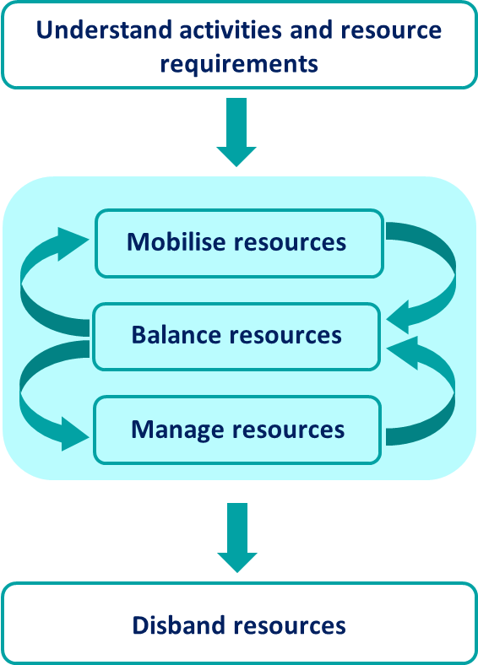
Mobilising Resources
Mobilisation makes sure that appropriate infrastructure and resources are in place ready for implementing the activities in the project plan and dismantled or redeployed when no longer required.
Mobilisation occurs throughout the life of the project. In the early stages of a project mobilisation will put in place;
  Teams
  Governance
  Infrastructure
Mobilisation for the full project will occur once authorisation has been given with the sign off of the Business Case.
The resource management guide may be useful to refer to.
    Helpful Tip On many projects there may be a well-established team already in place so no mobilisation may be needed, it’s more about getting the team ready to start work on the new project.
Planning
Project manager role
Resource management
Project finances
Project structure & governance

Slide 47
Project Manager Role in Delivery Stage
When the project implementation begins, the project team starts the work defined in the project plan to produce the deliverables. The role of the project manager during the stage is detailed in the diagram below.
As part of this stage, the project team is also required to deliver the actions within the communications and
engagement plan and ensure that the change management plan is being implemented.
  Delivering a Project
  Effective Leadership
Create Deliverables
Resource Usage
Monitoring the Project
  Reviews
Change Control
Communication Engagement
Conflict Management
Quality Assurance
Reporting
Mobilising resources
Reporting
Leadership & team management
Resource management
Professionalism
Project delivery
Communications management
Risk & issue management
Project finances
Project structure & governance
Quality management & assurance

Slide 48
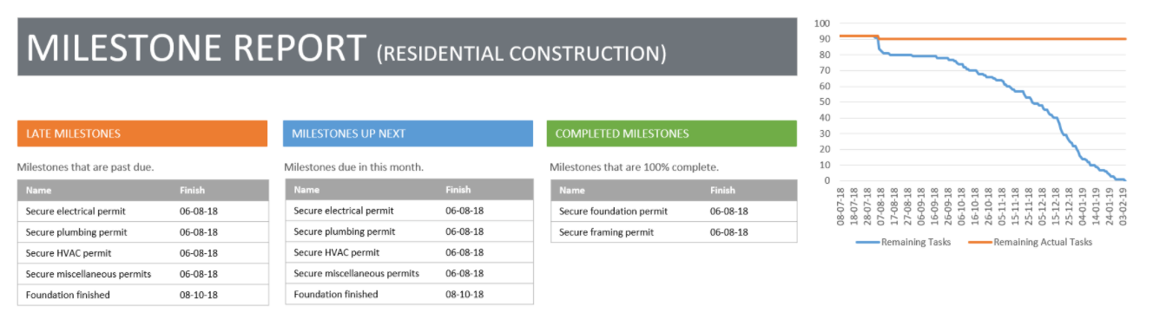
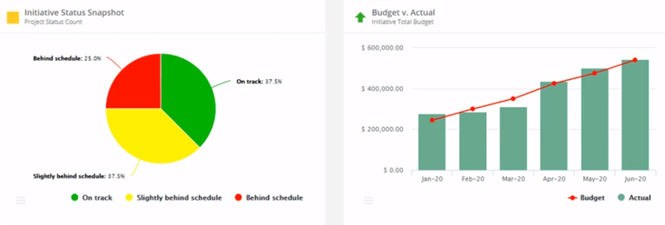
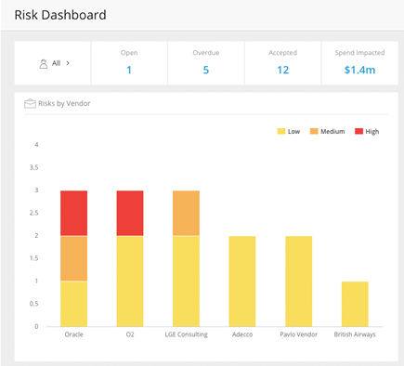
Reporting
Reports are an essential element for running successful projects. Reports document the health of a project over time and can give early warning if a project is going off track or not delivering what it has promised.
Risk Reports
Resource Reports
Progress Reports
Reporting keeps stakeholders informed and provides assurance about the progress of the project and crucial information when decisions need to be made.
Risks and issues are regularly reviewed and monitored to ensure that project progress will not be compromised.
Resource reports check that the project is using the level of resources forecast. This could include cost, materials or hours of effort amongst other things.
Milestones are commonly reported on in all projects and to check that deadlines are being met and deliverables completed on time.
Planned, completed and remaining tasks may also be reported as well as quality reports to check that plans are being followed and to ensure no creeping of scope.
Click on each of the images to see more about the type of reports that used in projects.
  Helpful Tip Celoxis is a really good tool for producing reports for project progress and maintaining the critical path.
Project manager role
Change control
Project delivery
Communications management
Risk & issue management
Project finances
Project structure & governance

Slide 49
Change Control
In any project, it is likely that changes will be proposed to the project which could have an impact on the project. The project manager is responsible for ensuring that the consequences of these changes are understood so that the sponsor can make informed decisions based on the impact of the changes, before they are implemented.
Change control is the process through which all requests for change are managed.
The diagram below shows the steps a change control process should include:
Identify
Model
Plan
Implement
Communicate
Scope
Current state
Future state
Results
Concept
Gather information
Model change
Analyse risk
Cost of change
Plan actions
Clear steps
Prepare reports
Gain approval
Action plan
Implement
Evaluate
Update baseline
Communicate to stakeholders
Share updated
plans
  Helpful Tip In order for the change control process to work effectively, it is essential that your project plan is baselined so you can demonstrate the impact of changes to the project. If change is implemented following the change control process you should re-baseline, change plans where needed and share those changes.
Reporting
Deliverables
Leadership & team management
Resource management
Project delivery
Communications management
Planning for success
Risk & issue management
Project finances
Project structure & governance
Quality management & assurance

Slide 50






Deliverables
Having a formal process in place to sign off the deliverables helps the Project Manager/Team and the stakeholders have clarity around exactly what is being delivered and to what quality standards.
During the project, tasks and deliverables
progress and project scope are reviewed
at regular intervals and, as with many
projects, may shift so acceptance
criteria is adjusted as needed.
The deliverable document is signed
off by the deliverable owner and then
saved as part of the project
documentation.
Quality
assurance can be used to check whether the quality criteria has been met
Deliverable
Sign off checklist
Deliverable
Acceptance criteria constantly reviewed
Change control
Stage sign off
Project structure & governance
Quality management & assurance

Slide 51
End the Delivery Stage
At the end of the delivery stage a decision is needed to confirm that the project can move to the close stage. The following checks need to be made before this can happen.
The Project Manager
Makes checks to ensure that all deliverables have been completed
Ensures that no other activities need to take place
Creates the end of stage report recommending that the project move to the close stage
Reflect on lesson learned throughout stage and update lessons log
The Project Sponsor
Reviews the work that has been done
Gives agreement to sign off the deliverables as completed
Confirms they are happy for the project to proceed to the close stage
Gains approval through the governance structure
Deliverables
Close Stage
Communications management
Project structure & governance
Quality management & assurance

Slide 52
Close Stage Contents
Start
  Close Stage Introduction
  Close Stage Tools & Templates
  Close Stage Steps
  Handover of Project Deliverables
  Ensure Benefits Realisation Plan in Place
  Handover Residual Risks
  Capture Lessons Learned
  Create the Project Closure Report
  Close Project and Disband the Team
Planning and
Design
Delivery
Close
Stage sign off
Introduction

Slide 53

Close Stage Introduction
All projects should be finite and have a defined start and end point.
The project manager initiates the closing a project stage when all the deliverables that have been specified in the business case are completed. This vital step in the project lifecycle allows the team to evaluate and document the project and move on to the next one.
Closing a Project Objectives
Verify user acceptance of the project’s products
Ensure that products can be supported after the project is disbanded
Review the performance of the project and collect lessons learned
Assess the benefits already realised and plan review of benefits that will be realised after the project is complete
Address open issues and risks with a follow-up on action recommendations
Closure or termination of a project may take place if:
  All actions in the implementation plan have been completed
  Changes to scope or other factors may negate the need for the project or make the project unviable to continue.
It is an important part of the project managers role to know when a project should not continue and be prepared to request early termination.
The Objectives of Closing a Project
Contents
Tools & templates

Slide 54
Close Stage Tools & Templates
The main tools and templates that you will use during the close stage are listed below, along with some key guides to help you plan your project ready for implementation.
Further tools, templates and guides can be found in our Tools & Resources page on the website: Transformation – Our Dorset ICS Transformation
Tools & Templates
Guides & Training
Closure Report Template
Lessons Log
Lessons Learnt
Introduction
Close stage steps

Slide 55
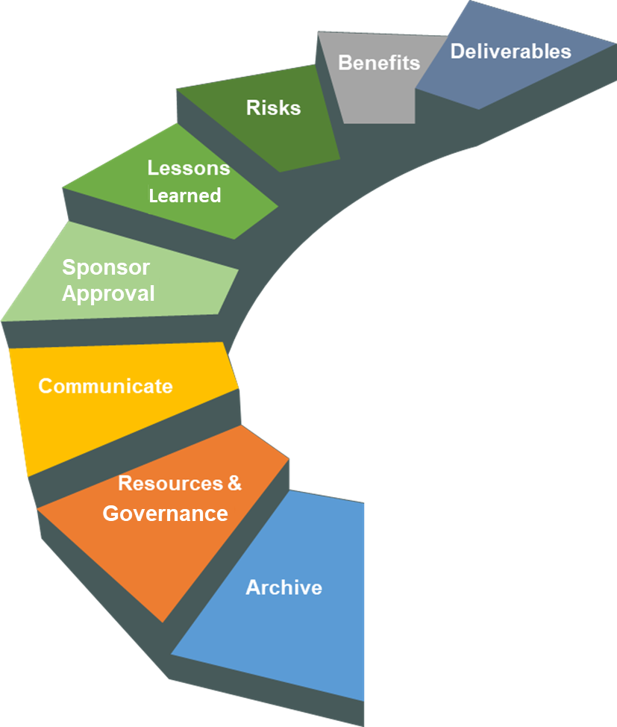
Close Stage Steps
There are a number of tasks that need to be completed to close the project.
Whilst they do not all need to be completed in sequence, there are some tasks that do need to be completed before others.
Deliverables x
Resources and Governance X
Archive X
Risks X
Lessons Learned X
Sponsor Approval x
Benefits X
Communicate X
Click on each step of the diagram to see what needs to be done at each stage.
Confirm the completion and formal acceptance of project deliverables ensuring they meet specifications to achieve the benefits expected.
Close down project governance and disband the project team and resources.
Archive project data and store any project documentation.
Handover of any residual risks and identify risk owners.
Run final project reports for review and capture any lessons learned.
Gain approval from the project sponsor/board/steering group to close the project.
Ensure benefits realisation plan is in place and benefits owner identified. Check that the benefits can still be achieved and will bring the value as expected.
Communicate to stakeholders that the project is completed.
Tools & templates
Deliverable handover

Slide 56

Deliverable Handover
Handover of deliverables to the business may occur throughout the project life cycle. However, before final closure can take place, all of the deliverables must be signed off and handed over to the deliverable owner and the team that will be using or need them.
Each deliverable should:
  Have a deliverable owner identified
  Have agreement that the deliverable does meet the acceptance criteria
  Be signed off by the sponsor & deliverable owner
  Be recorded and documented as part of the project archive
The deliverables should be handed over with a Handover Report that confirms the acceptance criteria/specifications.
Often this will be accompanied by:
  Release Notes
  User guides or training to help the owners and teams make best use of the new product or service.
Close stage steps
Benefits plan
Leadership & team management
Professionalism
Project delivery
Communications management
Project structure & governance
Quality management & assurance

Slide 57

Benefits Plan
When closing the project, the Project Manager needs to review and update the benefits realisation plan and the performance framework.
  A Benefit owner within the business as usual environment for each benefit should recorded
  A final Benefits realisation and handover report is produced
  Benefits handover plans should also be put in place as usual
Benefits Plan
The benefits plan should also include:
Plans for regular reviews of the deliverables and their use to ensure that they are fully embedded and still able to successfully provide the benefit intended
Levels of benefits expected
Timelines of when benefits should be expected
Tools and resources to ensure benefit realisation can be sustained and improved upon over time.
Taking these steps will ensure that:
  Benefits are tracked and sustained long after the project has closed
  The products/practices that the project has delivered are embedded into the culture of business
  Stakeholders are reminded what benefits they can expect to see and when.
What should the Benefits Plan include?
Deliverable handover
Handover residual risk
Professionalism
Project delivery
Planning for success
Quality management & assurance

Slide 58
Handover Residual Risks
Residual risks are the remaining risks on the project after closure and those risks that are expected.to remain after the planned responses have been taken, as well as those risks that have been deliberately accepted.
Handover of the risks should take place with the corporate risk teams and risk owners. A final risk report should be run and documented for the project archive and should include clear guidance on how to review and manage the risks going forward.
Residual Risk Handover
Steps for handing over residual risks
On closing the project:
  The risk register should be reviewed
  Any residual risks identified
  Mitigation plans for each residual risk should be reviewed or drawn up if they do not exist already
  An owner within the business for each risk should be identified.
Risk ID | Risk Title | Risk owner | Primary Risk Categories | Next review date | Causes of Risk | Mitigating Action | Likelihood Score 1-5 | Consequence Score 1-5 | Residual risk at Review
COV_R1 | Work pressures on nursing services | John Smith | Impact on safety of patients, staff, public | 01/07/2020 | Overwhelming work load & staff absence due to sickness | * Increasing staff numbers from returning nurses scheme * Reducing services on offer during pandemic to enable staff redeployment * Large pool of cover staff to call on when needed | 4 | 4 | 16
COV_R4 | Capability of staff to work from home | Simon Black | Human Resources | 01/07/2020 | Social isolation will mean as many staff as possible working from home. There are known issues with internet for some staff and the availability of physical infrastructure for productive working. | * IT to support staff with internet queries/issues, * Ensure that all staff have access to mobile phones to enable connection to internet if absolutely necessary * Provide access to monitors, chairs etc. to be taken home where needed | 2 | 2 | 4
Benefits plan
Capture lessons learned
Project delivery
Communications management
Planning for success
Risk & issue management
Project structure & governance

Slide 59

Capture Lessons Learned
Capturing lessons learned in a Lessons Log should be an on-going effort through all stages of the project.
A lesson workshop could also be held to facilitate capturing of lessons.
Click on the image to see more about lessons workshops.
One to one meetings with the project team are also advised to give
them constructive feedback to help them with their personal development
and capture further lessons learned.
Once captured, lessons should be stored in a location where the whole system can access these and be shared as widely as possible.
Lessons Workshops
Lessons workshops should be a facilitated session and team/board members and stakeholders from all parts of the project (including client representatives) should be included.
The workshop look at:
each of the project stages
processes and plans
discuss how work progressed
what was done right, what went wrong and what could be improved
any survey results could be reviewed
  Helpful Tip Lessons learned could also be added as a standing item to each project team meeting or using project close surveys to capture the thoughts of stakeholders to be reviewed at a whole team lessons learned workshop.
Handover residual risk
Project closure report
Leadership & team management
Professionalism
Project delivery
Communications management
Conflict management
Planning for success
Project structure & governance

Slide 60

Project Closure Report
The project closure report describes how you intend to close your projects. Every project manager needs to complete a project closure report to gain agreement and formal sign off from their sponsor that the project is ready for closure.
Once the project closure report has been approved, the PM can proceed with the actions needed to close the project. The project closure report confirms that the objectives have been met, the deliverables have been handed over and that project closure can commence.
Project Closure Report
Overview of project successes and failures
Review of the business case
Final actions that need to take place
Lessons learned report
In the report the project manager will review the successes and/or failures of the project against the business case and confirm any outstanding actions that need to be taken.
Click on the report image to see what it should include.
Capture lessons learned
Close the project
Professionalism
Project delivery
Communications management
Project structure & governance

Slide 61

Close the Project
The final step in project closure is for the project manager to formally close the project down:
  Communicate to all stakeholders that the project is completed
  Project team members can be released from their project teams to return to business
  as usual roles or move on to other projects.
  Project documentation should stored and archived
  Lessons learned shared across the business
Some projects need be closed prematurely.
This may be as the result of a decision made as part of the change control process; continuing work on the project may no longer be appropriate.
Reasons a project might close early
Insufficiency of Resources
Technical Constraints
Culture of the Organization
Financial Constraints
Prevailing Market Conditions
Customer Needs
Reasons a project might close early
Project closure report
Project themes
Leadership & team management
Resource management
Professionalism
Project delivery
Project structure & governance

Slide 62
Risk and Issue Management Theme
The aim of project risk and issue management is to support better decision-making through a good understanding of risks and issues and their likely impact.
  Tools and Templates
  Introduction to Risk and Issue Management
  Risk Management Process
  SWOT and PESTLE Analysis
  Issue Management
Close the project
Risk tools & templates

Slide 63
Risk & Issue Management Tools & Templates
Further information and training on risk & issue management is being developed and will be available in due course.
In the meantime, you may find the below resources useful which can all be found in our Tools & Resources page on the website: Transformation – Our Dorset ICS Transformation
Tools & Templates
Guides & Training
RAID Log (Risk, Assumptions, Issue, Dependencies)
Risk Matrix
A Risk Matrix for Risk Managers
Risk theme contents
Introduction to theme

Slide 64
Introduction to Risk & Issue Management
A project risk is an uncertain event or condition that, if it does occur, will have a positive or negative effect on a project's objectives.​
Risk management focuses on identifying, assessing and planning responses for risks to the project. Not all risks are negative events, some may have a positive effect on the project, and these are known as opportunities. All are managed through the risk register but will have different responses depending on the impact the risk will have.
A risk becomes an issue when an unplanned event or condition has taken place that has negative consequences for the project.
Issue management is the process of identifying and resolving issues. Issue management will utilise the outputs from the project risk register if the issue was previously identified as a risk during the risk management planning process.
Risk tools & templates
Risk management process

Slide 65
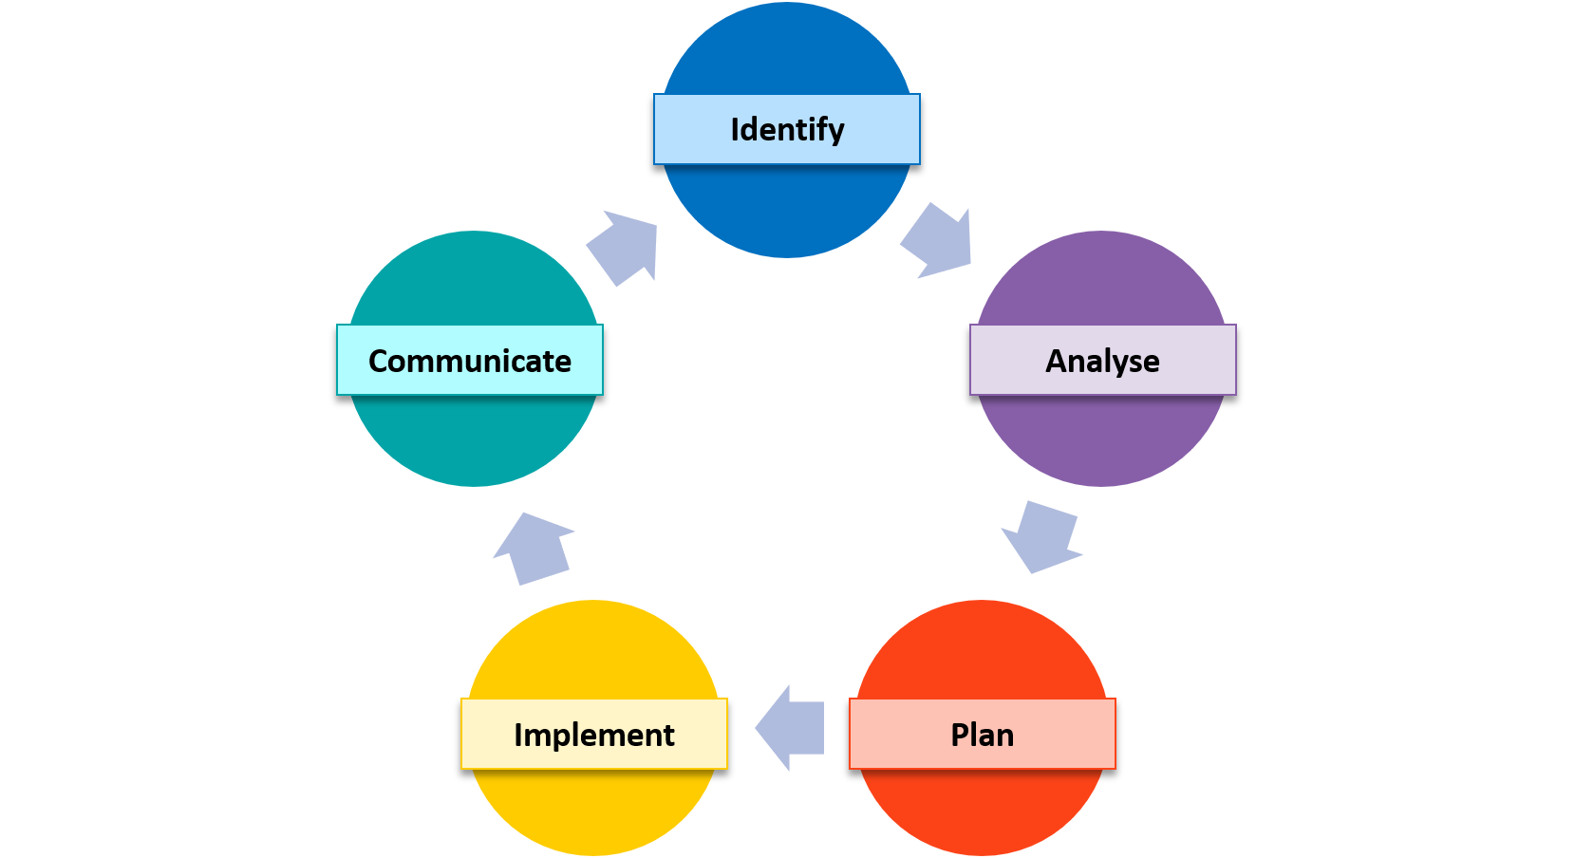
Risk Management Process
The process of risk management involves the following steps as illustrated.
  Identify
  Analyse
  Plan
  Implement
  Communicate
Further information on each activity in the process can be found by clicking on each of the steps in the diagram.
Risks should be recorded in the risk log and reviewed on a regular basis.
Analyse
Identify
Plan
Communicate
  The next step is to assess the risk and categorise it according to risk rating. This will help inform the next step when planning responses to the risk.
  This step is concerned with assessing the probability or likelihood of the risk and the impact or consequence if it does occur. The proximity of the risk i.e. when the risk is likely to occur is also assessed.
Risks are usually scored for likelihood and impact, commonly using a numerical system. e.g. 1 to 5 (where 1 is least and 5 highest). The scores are then calculated and an example of how the score is categorised into the risk rating is below.
The first step in the risk management process is to identify and describe the risks that might affect your project or its objectives. There are many techniques you can use to discover project risks including, SWOT & PESTLE analysis and risk workshops.
Whatever method you use, it should be collaborative and include internal and external stakeholders. During this step you will need record your risks in a risk register.
Describing Risks it is common practice to describe risks using “Cause, Event, Effect”. These generally take the form of “If, then, so” Statements: e.g. “If additional funding is not found, then the project will not be able to pay contractors to complete the implementation and so project completion date will be significantly delayed.”
  This step is where specific responses to risks are planned. The types of risk response that could be considered are below:
  Avoid – change your strategy or plans to avoid the risk
  Transfer – transfer the risk to a 3rd party e.g. purchase fire insurance for an unfinished building
  Accept – There maybe no direct response but addition budget may be set aside as contingency if the risk occurs
  Share – share the risk across multiple partners or teams e.g. for scarce resources
  Mitigate – put plans in place so that if the risk does occur it’s impact will lessened
  Enhance – if the risk would have a positive effect on the project then it’s an opportunity and enhancement may benefit the project
  Communication is carried out continually to keep both the project team and all stakeholders informed about the risks.
  Monthly reports will include information about new risks, closed risks, any changes to risks and any that have become issues. Any risks that are above set levels will be included in board reports and escalated if required for further decisions or advice to be given.
  Any changes that are made to the project due to risks being identified or becoming issues should to be communicated as detailed in the project communications plan to all stakeholders.
Implement
  This step ensures that the responses that are identified and planned in the previous steps are actually carried out and that these responses are having the desired effect on the risk.
  The risk owner is responsible for ensuring the responses are carried out, as well as monitoring the effect on the risk.
  The risk actionee is responsible for carrying out the specific response actions.
Introduction to theme
SWOT & PESTLE

Slide 66

SWOT & PESTLE Analysis
There are many different techniques that can be used to identify risks. Two of the most commonly used techniques are SWOT and PESTLE.
The SWOT technique looks at the following:
  S​trengths - attributes of the organisation or solution that may help achieve the project objective
  Weaknesses – attributes of the organisation or solution that may hinder or prevent the achievement of the project objectives
  Opportunities – external attributes that may help achieve the project objectives
  Threats – external conditions that may harm the projects success
PESTLE analysis looks at external factors that may affect a project’s
success or need to be considered as part of the project planning.
Click on each of the letters in the diagram to see more
About PESTLE.
Legal
Environmental
Political
Technological
Social
Economic
  Legal factors include:
    Discrimination law
    Employment law
    Health and safety law
  These factors can affect how a company operates. You also need to consider new laws originating from acts of Parliament, interpretations of the law by courts (both Domestic and European), International Laws.
  Social factors include the cultural aspects and health consciousness;
    Population growth rate
    Age distribution
    Career attitudes
    Emphasis on safety
  Trends in social factors affect demand for products and services. For example, the ageing population may imply the need for more services for older people. Management strategies may need to adapt to social trends and consider when planning projects.
  Economic factors include:
    Economic growth
    Exchange rates
    Inflation rate
    And interest rates
  These factors greatly affect how businesses operate and make decisions. For example, interest rates affect the cost of capital and therefore to what extent a business grows and expands. Exchange rates can affect the costs of exporting goods and the supply and price of imported goods in an economy.
  Environmental factors include ecological and environmental aspects such as:
  Weather
  Climate
  And climate change
  These may especially affect industries such as tourism, farming, and insurance. Growing awareness of the potential impacts of climate change may affect s project approach to consider the affects of the project e.g. pollution, recycling, carbon reduction etc.
  Technological factors include aspects like:
  Research & design activity
  Automation
  Technology incentives (funding for using new technology)
  And the rate of technological change
  These can help define barriers to entry, new ways of working, new methods of treatment and affect project decision making.
  Political factors relate to how the government intervenes in areas such as
    Tax policy
    Labour and wage policies
    Trade restrictions and/or tariffs
  Government policies may have a high impact on health, education, and infrastructure projects.
P
E
S
T
L
E
Risk management process
Issue management

Slide 67
Issue Management
Issue management helps project teams deal with issues quickly and efficiently and keep the project on track. The issue management process helps the project manager visualise and track who is resolving the issue, how they’re resolving it, and when it will be resolved.
Issues may arise when an identified risk event takes place or may occur from a previously unidentified risk. If the issue has risen from an identified risk, then actions to address the issue should have already been planned as part of the risk management strategy.
Once an issue has arisen the steps to address the issue reflect those of the risk management process and are as follows:
  Identify
  Analyse
  Plan
  Implement
  Communicate
SWOT & PESTLE
Assumptions, constraints & dependencies

Slide 68
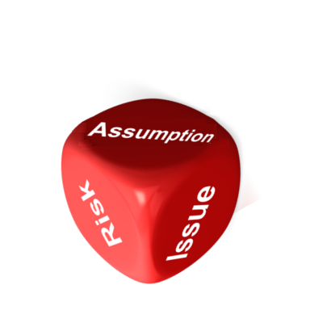


Assumptions, Constraints & Dependencies
Alongside risks and issues the project manager also needs to consider what other factors or events, outside of the project’s control, may affect the project.
Assumptions, Constraints and Dependencies should all be logged and monitored with actions planned for each if things do not go according to plan. Often the logging of these is combined into one register along with risks and issues known as a RAID log.
Click on the images below to see more about these.
Dependencies
  Project Dependencies are events or actions that the project is dependent on for it to be able to meet its objectives. These may be other projects or other external factors not in the control of the project manager. They need to be recorded, monitored and planned for as the success of the project may be determined by on them.
  Examples of project dependencies could include:
  Project 1 for the build of a new community hub must complete before the ‘new community service’ pathway (project 2) can implement their changes
  Finances have been secured and transferred to the trust for procurement of equipment
  IT have completed their project to upgrade networks to N3 and LAN connections in order for this project’s software to work efficiently
Constraints
Assumptions
  Project Constraints are anything that restricts the project in any way. The three major constraints are; time, cost and quality.
  However, projects can be constrained by factors other than these as well. These can often be identified by using PESTLE. Examples of other constraints could be:
  Technological – e.g. limits to what can be implemented due to the IT equipment in current use
  Environmental – e.g. rules that do not allow certain materials to be used
  Political – e.g. embargoes on selling to certain countries due to economic sanctions in place
  Project Assumptions are events or circumstances that are expected to occur during the project life-cycle. These may have positive or negative effects on the project outcomes and should be recorded and planned for if they do happen as expected or if they unexpectedly do not happen.
  Examples of assumptions could be:
  The UK will leave the EU through Brexit in Dec 2020
  Additional funding will be available in the new financial year
  The supplier will deliver the IT system on time
Constraints
Assumptions
Dependencies
Issue management
Resource management

Slide 69
Resource and Team Management
Resource and team management is the process of pre-planning, scheduling, and allocating your resources and team to make the most effective use of resources and people on your project.
  Resources and Team Management Tools & Templates
  Resource Management
  Resource Management Techniques
  Resource Levelling
  Resource Smoothing
  Team Management
  Team Structures/Types
  Team Development Stages
Assumptions, constraints & dependencies
Tools & templates

Slide 70
Resource & Team Management Tools & Templates
Further information and training on resource and team management are being developed as part of the project management training competency framework and will be available in due course.
In the meantime, you may find the below resources useful which can all be found in our Tools & Resources page on the website: Transformation – Our Dorset ICS Transformation
Tools & Templates
Guides & Training
Resource Management Plan
RACI and RAPID Templates
Lessons Log
Responsibility Charting
Lessons Learnt
Theme contents
Resource management

Slide 71
Resource Management
Successful utilisation of resources during projects involves understanding what activities are to take place and allocating resources accordingly. Mobilising the resources in a timely manner and balancing and managing the resources throughout the phases ensures that bottlenecks and resource drought are avoided, and resources are utilised to their maximum capacity.
For further information on the steps in the process click on each of the activities in the diagram.
Understand Activities and Resource Requirements
Manage Resources
Disband Resources
Mobilise Resources
Understand Activities and Resource Requirements
Balance Resources
As with any team or set of resources, these need to be managed to ensure that they are all working efficiently together, understand different ways of working, prioritise work and keep the team focussed.
When the work for an activity is completed and a resource is no longer required, the resource should be released or taken off the project so that they can be utilised elsewhere. At the end of the project, all resources are disbanded.
At the end of each phase of the project the project manager will plan for the next phase and put in place the resources ready to start activity as detailed in the resource management plan.
As part of the defining the project process, activities for each phase of the project are identified. For each activity the project manager will define and establish the resource needed to complete this.
Once the project manager has established what resources are required and when, plans will then be put in place to ensure that the correct resources are available and ready to be mobilised at the right times to coincide with project activities that need to be completed.
As work progresses, issues or changes may arise and the project manager will need to balance resources accordingly. E.g. if a team member is off sick, other resources may be called in to assist or timelines may need to be adjusted.
Mobilise Resources
Balance Resources
Manage Resources
  Helpful Tip A resource management plan is a useful tool in planning what resources you need and when. A template can be found in the tools and resources library.
Disband resources
Tools & templates
Resource techniques

Slide 72

Resource Management Techniques
Scheduling resources requires more than a consideration of sequential logic and estimating. Even when money is no object resources may be limited and constrained​.
It rarely happens that you have all resources as per your schedule and there is always a risk that during the project resources may be taken away and you will have to manage with less.​ When you have all necessary resources, the project manager’s responsibility to use resources efficiently and save costs for the company.​
To achieve these objectives, you use resource optimisation techniques.
Two such techniques are listed below and using these will allow you to complete
the project with minimal obstruction.
    Resource Levelling
    Resource Smoothing​
  Helpful Tip Resources are often shown in a histogram bar chart. The resource histogram shows the amount of use and availability for the resource
Resource management
Resource levelling

Slide 73
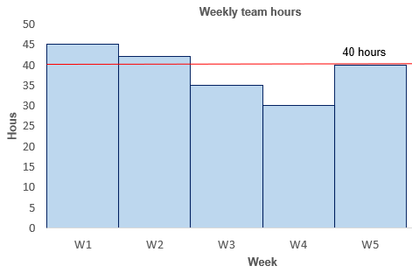
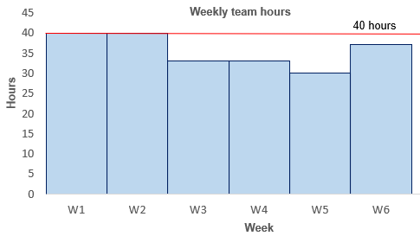
Resource Levelling
You use resource levelling when you have limited resources and you may extend the schedule.​ It is used when:
  A critical resource may not be available for a certain duration or may not be available at a certain point of time
  You have to share a resource with another project
  The demand for a resource exceeds the supply
You also use this technique when you must keep some resource usage at a constant level.​
In resource levelling, you are asked to optimise the limited resources given to you where the schedule is not fixed.​
Resource levelling answers the question of when you will be able to complete the project with the given resources.​
Resource levelling is sometimes called resource constrained scheduling (RCS). If resources are not available, the project duration may change.
Resource Levelling
In the diagrams above the first diagram is the planned project schedule based on a five-week timeframe. Undertaking the project in this way means that some weeks the resource requirement is above the level of available resource (40 hrs) – so unachievable.
By delaying some tasks and using the task float the project can be extended to six weeks, levelling out the resource required each week to more even levels.
Example of Resource Levelling
Resource techniques
Resource smoothing

Slide 74
Resource Smoothing
You use resource smoothing when you have to optimize the resources and you cannot extend the schedule.
​
Since you cannot extend the schedule, the project completion date and the critical path will stay the same. Here the activities cannot be delayed more than their total and free float.​ Using float in this technique will cause you to lose some flexibility from your path; however, the schedule will be optimized, efficient and cost effective.​
In resource smoothing, you must be careful to avoid any delay in activity as it may affect your critical path.​ Time is the main constraint here. You have a fixed schedule and are asked to optimize resources.​
Resource smoothing is also known as time constrained scheduling (TCS). The project end date cannot be changed, and you have to optimize resources within the float.
Resource Smoothing X
Example of Resource Smoothing
In the diagrams above the total amount of resource and time are the same. However, using resource smoothing, the available resources have been spread more evenly through the life of the project to reduce the peaks and troughs in some weeks.
Resource remains under the resource cap (maximum resource available) of 40 hours at all times.
Helpful Tip Project float, also known as slack, is the amount of time by which a given
task within a project can be delayed before it impacts the deadline for the project.
Resource levelling
Team management

Slide 75
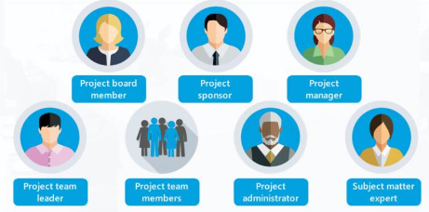
Team Management
Effective Team Management
Team management within a project is important to build effective and integrated teams, working together in collaboration towards a shared vision.
For teams to be effective it is important that team members understand their roles within the team and that their capabilities, preferences, ways of working and expectations as individuals are recognised, as well as the social dynamics between team members.
RACI (Responsible, Accountable, Consult, Inform) and RAPID (Recommend, Agree, Perform, Input, Decide) are useful tools for assigning roles in a project.
Establish a Balanced Team: Identify project team members with both the right technical expertise as well as a broad spectrum of communication and thinking styles
Ensure Clarity and ‘Buy In’ to the Project Objectives: Each team member needs to be clear and committed to achieving the project objectives. Providing the team with an opportunity to raise concerns or issues and get involved in the early stages of planning will help greatly
Establish a Team Code: Capture ‘expectations of the project leader’ and ‘expectations of each team member’ to work to
Recognise the Stages of Team Development: Adjusting leadership style to accommodate these stages will help the team develop more quickly
Plan How to Celebrate the Project Team Success: Make the project team members feel valued so more likely to respond well to future challenges that may lay ahead. Consider how you will celebrate success at the end of the project as well as ensuring the project sponsor is present to thank the team personally
Tips on effective Team Management
Resource smoothing
Team structures / types

Slide 76

Team Structures/Types
In a project teams may be structured in different ways. Four of the main types of project teams include:
  Functional Teams - Permanent teams with team members from the same department reporting up to one line manager
  Cross-functional Teams - Team members from various departments brought together to tackle specific tasks that require different inputs and expertise
  Matrix Teams – Similar to cross- functional teams, staff from various departments brought together. However, in matrix teams the team members will report to the project manager on a day-to-day basis but still retain their department team manager as their permanent line manager
  Contract Teams - Contract teams are outsourced teams brought in to complete a part of a project. After the project is completed and the contract has ended the team is disbanded
Team management
Team development

Slide 77
Team Development Stages
To achieve successful projects the people in the project team must be able to work together cohesively, but this does not happen automatically. At first they are not a team just individuals assigned to work on the project, the team develops as they work together. Over time the team get to know each other, what to expect from each other and how to coordinate their work. Through the process of team development they begin to operate as a team instead of a collection of individuals.
Bruce Tuckman, an educational psychologist, identified a five-stage process that most teams follow when going through team development. The stages that he identified are below.
Click on each stage to find out more about what happens to the team during that stage.
Adjourning
Norming
Performing
Forming
Storming
If a team has fulfilled its goals and objectives, The team will move into the adjourning stage. It is important to achieve closure for the team on a positive note. Team members motivation may decline when the group's work comes to an end, and some may feel a sense of loss. It is important to recognize the team members for their accomplishments and celebrate the team's overall successes. Some team members may also feel some uncertainty or insecurity about the future, team leaders and managers can help with through appropriate transition planning for the team.
In this stage conflict and interpersonal differences are resolved and a sense of cohesion and unity emerges. Team performance increases during this stage as members learn to cooperate and begin to focus on team goals. However, the harmony is precarious, and if disagreements re-emerge the team can slide back into storming.
By now team members work together easily on interdependent tasks and are able to communicate and coordinate effectively. There is a high level of cohesion and performance and fewer time-consuming distractions based on interpersonal and group dynamics. Motivation is usually high and team members have confidence in their ability to attain goals.
The team meets and learns about the opportunities and challenges that the project will bring. During this phase the team will be motivated and are getting to know each other. Focus should be on establishing group identity and purpose with the project manager taking the 'lead,’ and providing clear guidance, expectations and consistent instructions. Roles and responsibilities should be allocated taking into account the team members strengths and development needs where appropriate and encouraging team members to share knowledge and experiences.
The storming stage is a period marked by conflict and competition as individual personalities emerge. Team performance may decrease in this stage because energy is put into unproductive activities. Members may disagree on team goals, and subgroups and cliques may form around strong personalities or areas of agreement. To get through this stage, members must work to overcome obstacles, to accept individual differences, and to work through conflicting ideas on team tasks and goals and failure to address conflicts may result in long-term problems.
Forming
Storming
Norming
Performing
Adjourning
Team structures / types
Communications theme

Slide 78
Communication and Engagement
A communication (comms) and engagement plan identifies the means, the medium, the messages and frequency of communication between the different stakeholders for the life of the project.
  Communication and Engagement Tools & Templates
  Communication Process
  Communication Plan
  Communication Plan Contents
  Communication Channels
  Stakeholders
  Stakeholder Management
  Stakeholder Resistance
  Stakeholder Mapping
  Personality Types
Team development
Tools & templates

Slide 79
Communications and Engagement Tools & Templates
Further information and training on communication and engagement is being developed as part of the project management training competency framework and will be available in due course.
In the meantime, you may find the below resources useful which can all be found in our Tools & Resources page on the website: Transformation – Our Dorset ICS Transformation
Tools & Templates
Guides & Training
Communications & Engagement Plan
Stakeholder Mapping & Analysis
RACI and RAPID Templates
Communications Matrix
Responsibility Charting
Theme contents
Comms management

Slide 80
Communications Management
Communication management is the process of sharing information and engaging with stakeholders, and in some instances taking their feedback.
The communications management process will help structure your approach to communication planning and the creation of the communication and engagement plan.
The first draft of the communication and engagement plan should be completed at the outset of your project, in the scoping phase.
This ensures good, consistent communication is implemented from the start and reduces the risk on your project.
A:
Identify Audiences
B:
Analyse stakeholder interest and influence
C:
Understand comms and Engagement needs
D:
Manage stakeholder expectations
E:
Take Action
F:
Review and feedback
Tools & templates
Comms plan

Slide 81

Communications Management Plan
The first draft of the communication & engagement plan should be completed at the outset of your project, in the scoping phase. This ensures good, consistent communication is implemented from the start and reduces the risk on your project.
A communication and engagement plan identifies:
  Communication & engagement goals
  Stakeholder groups, influence, interest and needs
  Methods to communicate with each group
  Frequency & timing of communication
  Who will authorise release and who will deliver the information
  How sensitive/confidential information is communicated
  Standard templates, formats, or documents for communicating
Comms management
Comms plan contents

Slide 82
Communications Management Plan Contents
The communications management plan should hold certain key pieces of information relating to your planned communication and engagement with stakeholders. Click on each of the coloured boxes below to find out what information that section should include.
Approach & Messages
Continuous Improvement
Answers the question WHY?
Objectives
Timing & Frequency
Tactics & Channels
Objectives
Stakeholders & Audiences
Explain how often and when will you communicate:
  Will there be a defined schedule for the communications?
  Will different groups get communications at different times (e.g. will executive stakeholders always be informed before patients)?
  How will you handle ad hoc requests for information?
Stakeholders & Audiences
Answers the question WHO?
Define your approach for each stakeholder group.
  What will your style and tone be for each group?
  What formats will you use?
  What messages do you want to get across?
  How will your approaches vary depending on stakeholder interest/influence etc.?
  Who will send / lead the communications/engagement?
Define what tactics and channels of communication you will use:
  What tactics will you employ to address resistance or lack of interest?
  What channels are available to you, and which will you use for each group of stakeholders?
  Why have you chosen these and what benefits do you think they will offer?
  Are there any risks that you foresee?
Try to set the scene for the project. In this section you should outline:
  What is the background for the project?
  What are the projects drivers?
  What are the aims/objectives you are trying to achieve through your communications?
  How will communications help deliver the project?
Explain what you will do to ensure that your communications and engagement remains effective.
  How will you know if the comms & engagement are not achieving what you expect them to?
  How will you address this?
  How will you gather feedback and how/will this be acted upon?
  How often will you review/update the comms & engagement plan?
Identify your stakeholders and audiences for communication and engagement.
  Who are your primary & secondary stakeholders?
  What is their level of interest and influence?
  What particular aspects are they interest in / not interested in?
  Are the supportive or resistant?
Answers the question WHAT?
Approach & Messaging
Answers the question WHEN?
Timing & Frequency
Answers the question HOW?
Tactics & Channels
Answers the question HOW WELL?
Continuous Improvement
Comms plan
Comms channels

Slide 83
Communication Channels
Communication channels affect how efficient or inefficient the flow of information is within a project. Without an effective communication channel, project stakeholders may be frustrated by a lack of or unclear information or lose focus of the big picture, which goes on to affect their interest or decision making.
Choosing the right communication channel for your audiences is key to maintaining interest in your project.
Click on each type of communication in the diagram on the left to see more information.
Digital
Direct
Face-to-Face
External
Digital Communication
Direct Communication
Face to Face Communication
External Communication
Electronic communication channels encompass email, Internet, intranet and social media platforms. This channel can be used for one-on-one, group or mass communication. It is a less personal method of communication but more efficient. When using this channel, care must be taken to craft messages with clarity.
There is no pretence or hidden messages in direct communication; its purpose is quite simply to get or give information from one person or group of people to another and is marked by active listening and effective feedback.
This is the best channel to use for complex or emotionally charged messages, because it allows for interaction between speaker and recipients to clarify ambiguity. A speaker can evaluate whether an audience has received his message as intended and ask or answer follow-up questions.
External communication is the transmission of information between a business and another person or entity in the company's external environment.
Comms plan contents
Stakeholders

Slide 84
Stakeholders
Stakeholders are the people who are invested in the project and who will be affected by your project at any point along the way, and their input can directly impact the outcome. It is critical for the success of the project that these people are communicated with effectively.
They are typically:
  Members of a Project Team including Project Managers
  Executives, Project Sponsors
  Customers, Users and Suppliers
Project Managers should use a Stakeholder Analysis to identify the individuals and groups that the change impacts and understand their positions regarding the change.
Stakeholder Identification Questions
Who is affected positively and negatively by the project?
Who has the power to make it succeed (or fail)?
Who makes the decisions about money?
Who are the suppliers?
Who will use the deliverables?
Who has influence over other stakeholders?
Who could solve potential problems with the project?
Who is in charge of assigning or procuring resources or facilities?
Who has specialist skills which are crucial to the project?
  Helpful Tip You can help to kick start stakeholder identification in your project team group by having a brainstorming session and answering a series of questions. Click here to see the questions to ask.
Comms channels
Stakeholder management

Slide 85




Stakeholder Management
Stakeholder Management is the process that takes place before engagement can begin. Stakeholders are individuals or groups with feelings, perceptions, desires and influence.
Stakeholder Engagement is a way of achieving influence and positive outcomes through effective management of relationships.
APM defines it as “the systematic identification,
analysis, planning and implementation of actions
designed to engage with stakeholders”.
Why is it Important?
  Fewer surprises
  Better understanding of needs
  Better understanding of concerns
  Time invested in the right places
  Happier stakeholders
  Improved communication
  Better management of expectations
Engage early & often
Relationships are key
Actively seek input
Engagement first, scheduling second
Stakeholders
Stakeholder resistance

Slide 86
Stakeholder Resistance
In any transformational change there will be those that:
  Support or oppose it
  End up gaining or losing when benefits are realised
  See only a threat, perhaps convinced that they will lose despite all evidence to the contrary
  Are inherently indifferent to the change. They may become helpful or unhelpful, depending on how they themselves are managed and influenced
  May become either supporters or blockers of these benefits depending on how and to what level they are engaged.
By realising and identifying signs of resistance early the project manager can investigate the reasons behind these and can then try to address these by utilising strategies to turn around resistance and lack of support.
Further information can be found on the NHS Improvement website here.
Reasons for Stakeholder Resistance
There are many reason why stakeholders may be resistant to the changes you are trying to implement. Some of the main causes of resistance are listed below:
Technological – fear of new technology, too hard to use
Financial – the cost of implementing change and not being able to understand the benefits
Human factors – fear of losing their jobs, likes the way it works now
Reasons for Resistance
Stakeholder management
Stakeholder mapping

Slide 87
Stakeholder Mapping
The way in which you manage each group of stakeholders will vary according to their level of interest and influence and they can be mapped regarding their level of interest and influence.
Further information can be seen in the table to the right.
Raise interest
Engage & consult on interest area
Promote benefits
Try to increase level of interest
Key players
Focus efforts here
Involve in decision making
Engage & consult regularly
Influence of stakeholder
Keep informed
Inform via general communication methods
Try to increase level of interest
Keep engaged
Keep informed & consulted
Involve in low-risk areas
Potential supporter or ambassador
Interest of stakeholder
Stakeholder resistance
Personality types

Slide 88
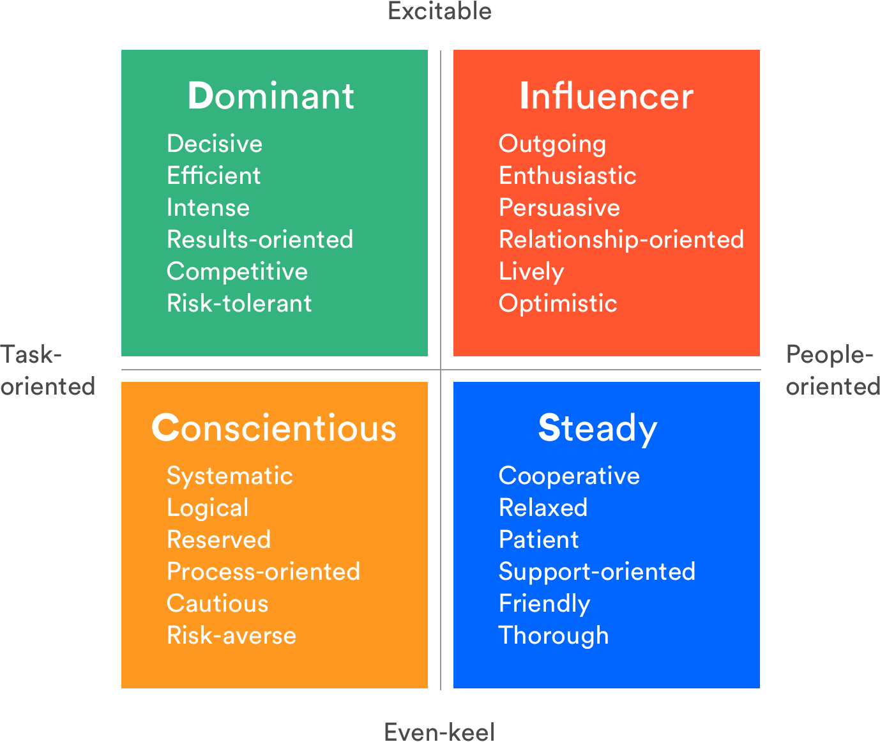
Personality Types
Conscientious Personalities
Influencer Personalities
Dominant Personalities
Differing personality types within a team will lead to different styles of communication and often this can lead to conflict.
Understanding the differences in communication styles and paying attention to which styles teammates gravitate toward and why, can improve team performance, interpersonal skills, build trust, and help the project team work more efficiently together.
Click on each of the personality types in the diagram to see more about the communication styles for that personality type.
Steady Personalities
Conscientious personalities prioritise attention to detail and place high value on competency. They jump at the chance to demonstrate their expertise and build new skills.
Try to…
  Be organised, provide as many details as possible up front
  Give them clear expectations and space to work independently
  Expect them to double- and triple-check all the relevant info before making a decision
Avoid…
  Framing feedback on their work as “criticism”
  Responding to them emotionally – use words like “know” or “think” instead of “feel”
  Expecting them to ease into a conversation with chit-chat
Influencer personalities are your classic “people” people. They are friendly, upbeat, and thrive relationships, which make them first class collaborators.
Try to:
  Approach them in a more relaxed manner and share your sense of humour
  Put details and facts in writing for them to refer back to after a verbal conversation
  Expect them to be a little too optimistic about ideas, as well as their own abilities and the abilities of those around them
Avoid:
  Talking down to them or being curt.
  Trying to confine the conversation or stifle their freedom to express ideas and emotions.
  Expecting them to dive into the details with you
People who have a ‘dominant’ personal style love action and are focused on results. A few things to keep in mind when communicating with dominant personalities:
Try to:
  Get right down to business, and stay on topic
  Be prepared to field follow-up questions on the spot so you can answer with confidence
  Expect them to be decisive and fairly blunt
Avoid:
  Taking their bluntness, questions or impatience personally
  Making promises you can’t deliver on
  Expecting them to share their weekend plans with you
People who have a ‘steady’ personal demonstrate conscientiousness, focus on building relationships and being a team player. A few things to keep in mind when communicating with steady personalities:
Try to:
  Provide with guidance and direction to help them complete tasks correctly
  Use a calm, agreeable tone and be considerate of their feelings
  Ask questions to understand where they may have concerns or thoughts
Avoid:
  Forcing changes on them to quickly
  Questioning their commitment or loyalty
Stakeholder mapping
Change management
Steady personalities
People who have a “steady” personal style put emphasis on cooperation They value consistency, stability, and loyalty.
Try to:
  Practice active listening, and confirm that you’ve heard them by summarizing what they’ve just said to you
  Approach them with a relaxed vibe, and break the ice by acknowledging a recent contribution they’ve made
  Expect them to ask for details
Avoid:
  Rushing them into a decision
  Assuming they support an idea 100% just because they don’t voice opposition
  Expecting them to know priorities and deadlines – it’s helpful if you spell those out

Slide 89
Change Management
The purpose of change management is to implement strategies for effecting change, controlling change and helping people to adapt to change.
  Change Management Tools & Templates
  Engaging Stakeholders in Change
  Readiness Assessments
  Stages of Change
  Creating the Climate for Change
  Change Control
Personality types
Tools & templates

Slide 90
Change Management Tools & Templates
Further information and training on change management is being developed and will be available in due course.
In the meantime, you may find the below resources useful which can all be found in our Tools & Resources page on the website: Transformation – Our Dorset ICS Transformation
Tools & Templates
Guides & Training
Rich Picture Vision Template
Commitment, enrolment and compliance
Change management
Engage to change

Slide 91
Engaging Stakeholders in Change
Engagement with stakeholders and wider team project is vital to communicate what is changing and why. Their continued involvement with defining the problem and developing the change solutions to achieve the vision will mean engaged stakeholders that will champion the project and help in the event of issues or threats to the project.​
​
Engagement helps builds relationships and in turn the cohesiveness of the team, getting them to work together, enabling people to contribute to their fullest potential and help project success.​ Establishing benchmarks to measure where you are now against the outcomes you want to improve and setting SMART (Specific, Measurable, Achievable, Realistic, Timebound) project objectives that will link to benefits will also aid success.
Measurable
Realistic
S
M
A
R
T
Specific
Achievable
Timebound
Tools & templates
Readiness assessments

Slide 92
Readiness Assessments
The management of change encompasses all approaches to prepare and support individuals, teams, and organisations in making organisational change.​ Organisational change is introduced into corporate settings through projects, programmes and portfolios in order to deliver business value. ​
​
Change needs to be planned. When you introduce a change you will impact one or more of the following areas:​​
  ​Processes​​
  Systems​​
  Organisation structure​​
  Job roles​​
​
Readiness assessments are tools used by a change management team or project leader to assess the organisation's readiness to change and can be used to evaluate the challenges and opportunities that may be faced in any area affected by the change. ​
Readiness Assessments
Common areas that readiness assessments may cover include:
  The size of the change
  Is there the capacity to change
  How many people are affected
  Is it a gradual or radical change
  How much change is already going on
  What type of resistance can be expected
  How will culture be affected
What do Readiness Assessments cover?
Engage to change
Stages of change

Slide 93
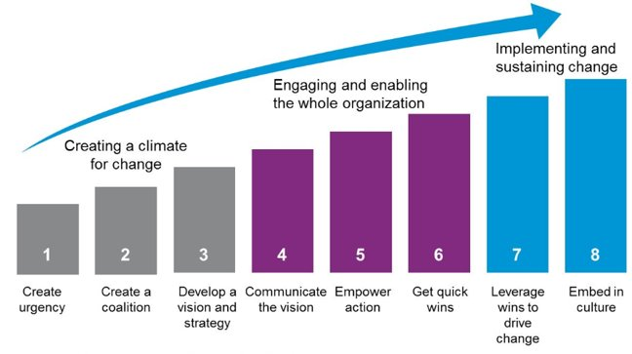
Stages of Change
There are many theories on how to implement
change successfully, however many of these
originate with leadership and change
management guru, John Kotter, a professor
at Harvard Business School and
world-renowned change expert.​ ​​
​
The theories define the stages that
should be considered but are flexible
to enable use and adaptation for any
project or change implementation.
Readiness assessments
Climate for change

Slide 94
Creating the Climate for Change
People are key to a project's success so engaging stakeholders early and getting them to acknowledge and understand the need for change is essential. ​
​
A first step is to develop a project vision statement by involving stakeholders, getting them onboard and be advocates for the project.
The vision statement clearly and briefly describes the desired outcomes to be produced for the business after successful project completion.
It is a vivid description of what the business will be like to inspire the project beneficiaries to initiate the project. A well-developed vision also helps teams and stakeholders understand the problem and avoids confusion about what the project hopes to accomplish. ​
​
Vision statements
Characteristics of a Good Vision Statement: ​
  Sets out current reality as part of the justification and need for change – why doing nothing is not an option​
  Is easily understood by a wide variety of stakeholders​
  Does just to the degree of change, describes a compelling/desirable future and reflects level of challenge​
  Avoids timeframes/specific details and key benefits of the change are implicit​
  Is short and memorable
Vision statement characteristics
Stages of change
Change control

Slide 95
Change Control
During the lifecycle of the project, changes to the planned work will occur. These may be requested or occur due to a shifting requirements or strategies or even perhaps a risk event.​
​
Change control is the process through which all requests to change the baseline scope of a project are captured, evaluated and then approved, rejected or deferred. The image below shows the process for controlling change.
Request for Change
Review Request
Assess Impact
Decide
Implement
Climate for change
Assurance theme

Slide 96
Assurance, Governance & Reporting Theme
Governance and assurance provides the mechanism for controlling and monitoring the project to enable project managers to provide confidence to decision makers in the project's viability.
  Tools & Templates
  What is Assurance and Governance?
  Project Assurance
  Project Governance
  Principles of Good Governance
  Project Governance Roles
  Project Reporting
  Progress Vs Performance Reporting
  Progress Reports
  RAG Status
  Manage by Exception
  Exception Reports
Change control
Tools & templates

Slide 97
Tools & Templates
Further information and training on assurance, governance and reporting is being developed and will be available in due course.
In the meantime, you may find the below resources useful which can all be found in our Tools & Resources page on the website: Transformation – Our Dorset ICS Transformation
Tools & Templates
Guides & Training
  Highlight Report (blank)
  Highlight Report PowerPoint Template
  Terms of Reference Template
  Meeting Agenda Template
  Meeting Minutes and Actions Template
Report on progress
Theme introduction
What is assurance?

Slide 98


What is Assurance and Governance?
Assurance is the process of providing confidence to stakeholders that the project will achieve its scope, time, cost and quality objectives, create the deliverables defined and realise the benefits predicted.
Governance can be defined as the processes, customs, interactions, policies and practices used by staff and stakeholders in the way the project is directed, administered and controlled.
Reporting will facilitate assurance and be one of the tools within the governance process that the project manager will use to monitor and control the project.
Tools & templates
Project assurance

Slide 99
Project Assurance
Project Assurance is when an independent party objectively assesses a project’s performance. It provides confidence to the business that its projects, programmes and portfolios are being well managed and achieve their quality objectives and able to realise benefits within the planned scope and time frame.
Assurance is the process of evaluating the health and viability of a project and its performance to provide confidence that the project is meeting its objectives and will deliver the benefits and value as set out in the business case.
Project assurance is external to the project team and can take several forms.
Click on each section of the wheel for further information on each of these.
Project
assurance
Programme & Portfolio Management Teams
PMO Teams
Audit
Quality Assurance Groups
Programme & Portfolio Management Teams
PMO Teams will conduct independent reviews on behalf of the business to provide confidence on the projects continued viability and health and alignment to strategy.
The PMO can also:
Support project teams to embed good governance
Assist project teams with documentation and templates
Provide best practice advice and guidance to project teams in the form of frameworks for project, programme and portfolio
PMO
Both internal and external audit teams can be tasked with auditing on behalf of the system. Audits can review all or just some of the project elements, including objectives, plans, resources, schedules, budgets etc. Audits give an unbiased review on how their projects are actually performing, any issues within the project and any immediate actions might need to taken to protect interests.
Quality Assurance Groups review the performance and deliverables from projects, programmes and portfolios to provide independent assessment and recommendation that the deliverables meet the appropriate quality and will provide the value expected. The groups are made up of professionals from across the system to provide a holistic assurance review.
Programme & Portfolio Management Teams will undertake reviews of their projects to ensure they are on track for delivery and are delivering to the quality standards.
Audit
Quality Assurance Groups
What is assurance?
Project governance

Slide 100
Project Governance
Governance is a necessary part of all projects in order to keep sponsors and senior management & stakeholders informed of progress and have confidence that investments are being well managed.
Project governance defines:
    A framework for reporting, control activities and delegated limits of authority
    Establishes escalation procedures for issues and change requests
    Ensure that roles and responsibilities within a project are clear.
Good Governance Benefits
The Benefits of Good Project Governance Include:
  Providing an organisation the required internal controls
  Reassuring stakeholders that the money being spent is justified.
  The optimisation of investment
  Motivation of staff through better communication
  Minimises risks arising from change and maximises the benefits.
Project Governance
Structure
People
Information
Good Governance Benefits
Project assurance
Governance principles

Slide 101
Principles of Good Governance
Board with overall responsibility for decision making
Appropriately delegated authority to act within their area of responsibility
Defined roles and responsibilities
An agreed business case
Defined method and lifecycle
Independent scrutiny and review throughout its lifecycle
Project objectives aligned to business strategy
Clear criteria for reporting the project’s status and escalation of risks and issues
An approved plan with clear phases and decision gates
Stakeholder input throughout its lifecycle
Culture of continuous improvement
Project governance
Governance roles

Slide 102
Project Governance Roles
The Project Board is made up of key stakeholders. They’re either the people who fund the project, users of the final product/service or suppliers.
On some projects there may also be advisory groups or committees. Forming an advisory group keeps stakeholders within the project and engaged without making decision-making cumbersome or inefficient.
Click on the roles in the diagram below to see more about each.
Organisation
Direction
Management
Delivery
Sponsor
Project board
User Representative
Supplier Representative
Project Sponsor
User Representative
Supplier Representative
Project Team
Project Manager
Represents the interests of the final users, comes from the business the project affects, may also have BAU interests for the benefits after project close.
Represents the suppliers or providers for the project, makes/supplies the deliverables. They may also add specialist knowledge or resources (e.g. new I.T. systems/IT engineers)
Is the business leader who plays a key role in promoting, advocating and shaping the project work. They oversee the project and programme management functions and remain accountable for ensuring the realisation of the specified benefits over time. They hold the project manager to account.
The project team works under the direction of the project manager. It is responsible for carrying out the work detailed in the project plan.
The Project Manager (PM) is responsible for the day-to-day operation and running of the Project. The PM makes sure things get done.
Project Manager
Project Team & Specialist Resources
Project reporting
Governance principles
Project reporting

Slide 103
Project Reporting
The purpose of project reporting is to monitor elements of the project to ensure that they are on track and gain early insight into any variances from what has been planned or is expected.
Project reporting involves the measuring actual project progress against planned progress in the key metric areas such as risks & issues and milestones & deliverables. Variations to scope, status of budget or costs and quality are also commonly reported on.
There are many reasons why reporting is a necessary function of project management and many types of report that can be run.
Not all of these will be written documents. Reporting can also be verbal, in
the form of dashboards or statistical charts.
Monitor Progress
Provide Updates to Stakeholders
Reporting
To Learn & Evaluate
Be Accountable
Governance roles
Progress v performance

Slide 104
Progress Vs Performance Reporting
Often, the terms progress reporting and performance reporting get used interchangeably but they are very different in nature.
Progress Reporting | Performance Reporting
Where the project, programme or portfolio is in its journey through its lifecycle It is concerned with deliverables and the work required to create them Progress reports contain milestones and activities and are focused on how the project is operating | Performance is about the objectives and benefits and the measurement of achievement Made up of metrics which describe how the project is making a difference and the impact of the change Can come in many different forms and styles; dashboards, scorecards, performance frameworks, logs, charts, written reports
Project reporting
Progress reports

Slide 105
Progress Reports
Highlight Reports inform stakeholders of how a project is progressing and are provided at regular intervals throughout the project’s lifecycle. The reports are used to monitor progress of the project and flag any particular issues or concerns to the board. The frequency and format of the reports are agreed as part of the project governance procedures at the start of the project.
The report provides the project board with a summary of the progress for the defined reporting period that the report covers and assures them that the project is viable to continue. It allows the board to monitor the project, flagging any issues or concerns and make decisions on corrective actions if needed and provides a mechanism for the project manager to escalate potential problems to the board.
Checkpoint Reports. Frequently in projects there will be a number of project work assignments going on at the same time, being undertaken or managed by different people. The reports are produced by team managers to update the project manager on the status and progress being made against pieces of work that they have been assigned to manage.
A checkpoint report is a regular time-bound report provided as the work is being undertaken. Often these will be weekly or fortnightly and may be in the form of a verbal or email update rather than a written formal report.
Progress v performance
RAG status

Slide 106
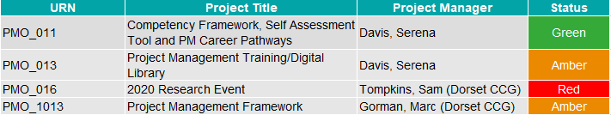
RAG Status
RAG (standing for Red, Amber, Green) status can be found in both highlight and checkpoint reports and is used for summarising how well a project or activities are progressing against planned progress using a series of traffic light themed indicators. It is extremely effective in project, programme or portfolio management because it enables the sponsors and senior management to quickly identify those projects which are in trouble and need support.
Red indicates the project is off track (for activities can sometimes be Not started/Overdue)
Amber indicates that the project is on track but monitoring maybe needed (or activities are in progress)
Green indicates the project is on track (or activities maybe completed)
  Helpful Tip Project management software will often calculate the RAG of a project or activity automatically or assign RAG status based on the start and end dates by calculating planned progress against actual progress.
Progress reports
Manage by exception

Slide 107
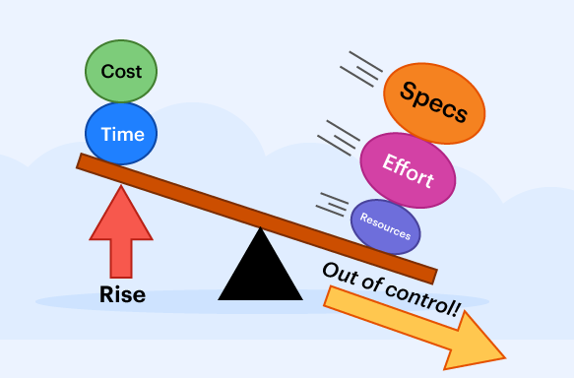
Manage by Exception
The project manager will have limits of authority, known as tolerances, in regard to changes to the project scope. This allows the project manager to manage the project as they see fit within the limits of their authority. When tolerances are likely to be exceeded the project manager have to escalate to higher authority and this is known by the term “Managing by Exception”.
When a project does breach its tolerances, it is important to respond quickly to correct the issue as the viability of the whole project may be at risk.
An Exception Report advises the sponsor and board about the breach and to recommend actions to respond.
The most common responses are:
  Take corrective action to bring the project back within tolerance
  Accept the breach and re-baseline the project
  Concede that the tolerance breach is too severe and terminate the project
RAG status
Exception reports

Slide 108
Exception Reports
As soon as a potential breach of tolerance is identified it is logged in the risk or issue register as appropriate and the project manager will prepare an exception report to present to the sponsor or board. The Exception Report is used to advise the of the potential issue and present recommendations and actions that need to be taken in order to resolve the situation.
The Sponsor/Board will agree on the course of action they wish the project manager to take authorise the appropriate actions to begin.
Exception Reports
The exception report, contains a description of:
  What the issue is / what is going beyond tolerance
  The causes of the breach
  The consequences if not addressed
  The recommended course of action including schedule of activity
  Often alternative options for addressing the issue
  How the future project will be affected by implementing the change
Exception Report Contents
Manage by exception
Benefits management

Slide 109
Benefits Management
Benefits management is the identification, definition, planning, tracking and realisation of benefits.
  Benefits Tools & Templates
  Benefits Management
  Benefits Realisation Process
  Benefits Identification, Value and Appraisal
  Benefits Planning and Implementation
  Benefits Handover and Realisation
  Benefits Monitoring and Reviews
  Benefits Strategy
Exception reports
Tools & templates

Slide 110
Benefits Tools & Templates
Further information and training on communication and engagement are being developed as part of the project management training competency framework and will be available in due course.
In the meantime, you may find the below resources useful which can all be found in our Tools & Resources page on the website: Transformation – Our Dorset ICS Transformation
Tools & Templates
Guides & Training
Benefits Template
Benefits Realisation
Theme introduction
Benefits management

Slide 111
Benefits Management
A Benefit is:
  A positive and measurable impact of change
  Can be tangible or intangible (e.g. Tangible = money saved, jobs created. Intangible = corporate reputation)
  May, or may not, be quantifiable in cash terms (e.g. reduced costs or greater customer satisfaction)
  Contributes to strategic objectives
Not all outcomes are positive - some impacts, known as Disbenefits, ​will be perceived as negative. These need to be recorded and tracked along with your benefits and could be treated risks and if occurring will be managed as issues.
Benefits Management is the identification, definition, planning, tracking and realisation of business benefits.
  Helpful Tip All stakeholders have a role to play in achieving successful outcomes. Benefits management helps align stakeholders with the reasons & options for change and in
  developing solutions.
Tools & templates
Benefits process

Slide 112
Benefits Realisation Process
Effective Benefit Realisation Planning enables organisations to maximise the potential benefits from the project.
At the outset of the project:
Objectives for the project are identified
These objectives will create Deliverables
Each deliverable will create Benefits.
The diagram to the right shows the steps in the
process,
A Benefits Realisation Plan is a document that details the benefits and the arrangements made to evidence their realisation.
1. Identify,
Value &
Appraise
3. Review &
Monitor
4. Handover &
Realise
2. Plan &
Implement
Benefits management
Identification & appraisal

Slide 113
Benefits Identification, Value and Appraisal
Once the Project Objectives have been defined the project manager needs to think about how these translate into Benefits. They also need to know how they are going to be measured, or in what way they could assess whether the benefits have been achieved.
Involve team members & stakeholders in benefits identification workshops
Look for benefits aligned to strategic objectives
Use benefits maps to identify and understand relationships between benefits
In options appraisals consider the benefits that each option delivers
Establish baseline measures & realistic benefit targets
Create Benefit Profiles for each benefit
Benefit Profiles
Each Benefit and Disbenefit should have a benefit profile. The data in the profile should include:
Benefit ID
Benefit Title
Benefit Description
Benefit Owner
Benefit Realisation Timescales
Benefit Measures
Benefit Profiles
Helpful Tip When defining your change success criteria, it’s a good idea to be specific. You don’t want to rush a project to bring it in on time if a few extra days, weeks, or
even months, brings more significant benefits.
Benefits process
Planning & implementation

Slide 114
Benefits Planning & Implementation
Benefits realisation planning is concerned with ensuring that the necessary plans, structures, governance arrangements and processes are in place to successfully implement the changes and achieve the benefits of the project.
This should include:
Categorising the benefits and linking them to the deliverable that will provide them
Establishing responsibilities for benefits realisation
Each benefits will have an owner (note – the deliverable owners and the benefit owners may not be the same person).
Establish the criteria to measure the success of the change / the level of benefits expected
Creating your benefits realisation plan
Benefits Realisation Plan
A benefits realisation plan is a document that details the benefits and the arrangements made to evidence their realisation. The plan can include:
Schedule for review of the benefits plan
Any pre-transition activities needed before handover to BAU
The business as usual benefit owner
The change which the benefits realisation depends on
Benefit descriptions and level of benefits expected
Current baseline is and how the level of change will be measured (metrics)
When the benefit is expected to be realised
Any risks and opportunities that may affect benefit realisation (also to be logged in risk logs)
Benefits Realisation Plan
Identification & appraisal
Handover & realisation

Slide 115
Benefits Handover and Realisation
As the deliverables are completed and handed over to the business owners, then benefits realisation will begin.
The Business Owners will;
Make sure that implementation of the deliverable is completed successfully so that the benefits can be realised
Ensure that there is regular monitoring before, during and after implementation of the deliverables both on the deliverables themselves and the level of benefits
Recommended or take corrective action if results are not as expected
Optimise changes for maximum benefit realisation
They may often use benefit dashboards to track benefit realisation progress
Evaluate realised benefits
Benefits Dashboards
Dashboards established for reporting benefits realisation can include:
Benefit ID
Benefit Title
Benefit Risk RAG Status
Forecast Value
Actual Value of Realisation
Enabling Change KPIs
Benefits dashboards
Planning & implementation
Monitoring & reviewing

Slide 116
Benefits Monitoring and Reviews
Regular reviews should take place throughout the project lifecycle and after the project has completed. These reviews will be undertaken by the relevant project team member during the life of the project or by the business owners after the project has closed.
The reviews should also inform stakeholders and board members of the progress being made in achieving the benefits.
Ultimately it is the sponsor that is responsible to ensure that the benefits detailed in the business case are realised.
The review should:
  Checks that the planned benefits remain achievable and have not changed in scope or value
  Ensure that benefits remain aligned to objectives and to reprioritise or realign them as necessary
  Identify any further potential for benefits
  Assess performance of the change against their original baseline performance levels and against the benefits realisation plan
  Review the effectiveness of the way in which benefits management is being handled
  Log any lessons learned to improve processes or revise benefits management strategy
Handover & realisation
Benefits strategy

Slide 117
Benefits Strategy
An organisations benefits management strategy defines the policy, approach, methods and processes for achieving benefits.
The strategy may include:
  Benefit Categories
  Benefit Mapping Techniques
  Roles & Responsibilities
  Benefit Processes
Monitoring and reviews
Introduction to framework

